Slide 1
Lecture Set 1
Part B: Understanding Visual Studio and .NET – Structure and Terminology

Slide 2
Objectives
Introduction to Visual Studio, .NET, & the IDE
Understand basic terminology – Visual Studio, .NET. Solutions, Projects, Applications, etc.
Learn how to create new Solutions, new Applications/Projects
General navigation around the Solution Explorer and Forms and applications windows in the Visual Studio IDE
Compiling and running programs
This will be presented in the first lab - LIVE

Slide 3
Visual Studio, .NET, and the IDE
Visual Studio 2012 is a suite of products that includes the .NET Framework and the Integrated Development Environment (IDE) you will be using
The .NET Framework supports four programming languages
  Visual Basic, Visual C#, Visual C++, Visual J#
  Also COBOL, with more to come
The Visual Studio IDE is your interface to .NET -- it is used to develop applications in any of the supported programming languages

Slide 4
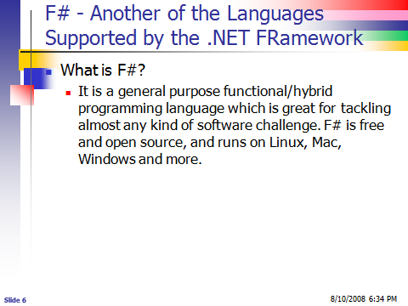
F#

Slide 5
The .NET Framework
Provides a common set of services that can be used when programming in any supported language
Enables you to write programs that run on any operating system on any hardware platform
Main components …
  .NET Framework Class Library (FCL)
  Common Language Runtime (CLR)
  We will learn a lot more about these in a bit and explain the rest of the terms in the next slide →

Slide 6
The .NET Framework (raising the bar)

Slide 7
Introduction to the Framework Class Library
Contains files of pre-written code organized as classes
The classes themselves are organized (grouped) into Java-like packages called namespaces
The groupings are done according to the functionality of the classes
There are many classes and many namespaces

Slide 8
Introduction to
The Common Language Runtime
The CLR manages the execution of .NET programs (called managed code)
Coordinates essential functions …
  Memory management
  Code execution
  Security
  Other services
Common Type System (CTS) is a component of the CLR that ensures that all .NET applications use the same basic data types regardless of the language they are coded in

Slide 9
Introduction to
The Integrated Development Environment
The IDE is the interface between the programmer and the .NET tools he or she uses
Includes design components for Console, Web, and Windows development (to name a few)
Includes an editor for all .NET languages as well as XML and HTML
Includes a comprehensive set of tools for forms design and code organization
  Methods
  Attributes (aka properties or data stores or …)
Many other features (some shown next) →

Slide 10
The IDE

Slide 11
Compiling & Running a VB Application
You will create a project made up of many files
The project will be contained within a solution
The compiler builds (translates) your VB source code into an intermediate language (MSIL) →
The result of this translation is packaged into a special container called an Assembly.
An Assembly is an (almost) ready to execute file with either a .dll or .exe extension
The Assembly is managed by the CLR
(to be discussed in more detail in Lecture Set 2)

Slide 12
Compiling and Running an Application

