Slide 1
Lecture Set 3
Introduction to Visual Basic Concepts Part B – Simple Controls, Event Handlers and Windows Forms Applications

Slide 2
Objectives
To gain an introduction to some simple controls
To understand more about the properties, methods, and events associated with controls
To gain an introduction to designing forms and writing the code behind to “make things happen”

Slide 3
Understanding the Name Property
Every form and control instance has a name
Visual Studio assigns a default name to forms and control instances – assign your own names
The value of the Name property is used to reference a form or control instance programmatically
Assigning meaningful names creates more readable code
Use consistent prefixes for form and control instance names
To get a list of controls on your forms – Click on
View → Other Windows → Document Outline
Better yet – draw your own form and name controls

Slide 4
Requirements for the Name property
The first character must be a letter
Subsequent characters can be letters, numbers, or the underscore character
Name must be less than 255 characters in length
Names cannot contain spaces
Names cannot contain special characters
Form names and control instance names must be unique

Slide 5
Some Control Prefixes
Control | Prefix
Button | btn
Label | lbl
OpenFileDialog | ofd
PictureBox | pic
ToolTip | tip
The text book has many more illustrations.
1/2/2016 4:56 PM

Slide 6
Properties of the Control Class
Controls are instances of classes
These are properties common to all controls and therefore inherited by all subclasses (individual control classes such as buttons, labels, text boxes, picture boxes etc) of the controls class
The text and background colors are specified by the ForeColor and BackColor properties
The Enabled property defines whether the control instance responds to end user interaction
Height and Width properties specify the size
Location property defines the position
Text property contains the text appearing in the control instance
Visible property defines whether the control instance is visible or invisible

Slide 7
Methods and Events of the Control Class
The Hide method makes a control instance invisible
The Visible property is set to False
The Show method makes a control instance visible
The Visible property is set to True
The Click event fires when the end user clicks the control instance

Slide 8
The Label Control
The Label control class derives directly from the Control class
Recall – all classes are descendants of the object class
A label is used to display textual information
This control inherits all the properties of the Control class, and it is a few unique properties of its own
Some of these properties are properties of some other control subclasses as well

Slide 9
Properties of the Label Control
The BorderStyle property defines the appearance of the border surrounding the label
The Font property defines the font of the text appearing in the table
The Alignment property defines the alignment of the text within the visible region of the control instance
Lots of other properties – do you know what some of them are?

Slide 10
Some Label Properties

Slide 11
The Button Control
The Button control is derived from the ButtonBase class
It supplies a clickable button
The CheckBox and RadioButton controls also supply clickable buttons
The CheckBox and RadioButton controls are discussed in subsequent chapters

Slide 12
Some Button Properties

Slide 13
The Button Control (Members)
The Enabled property defines whether the control instance will respond to events
The FlatStyle property defines the visual appearance of the button
The Text property defines the text appearing in the visible region
The Click event fires when the end user clicks the button

Slide 14
The PictureBox Control
The PictureBox control derives directly from the Control class
It displays images having formats of JPEG, bitmap, and others
The image can be scaled inside the control instance

Slide 15
The PictureBox Control (Members)
The BorderStyle property defines the appearance of the border surrounding the PictureBox
The Image property contains the image
The ImageLocation property contains the disk file name where the image is stored
The SizeMode property defines how the image appears (is scaled) inside of the PictureBox
The Click event fires when the end user clicks the PictureBox

Slide 16
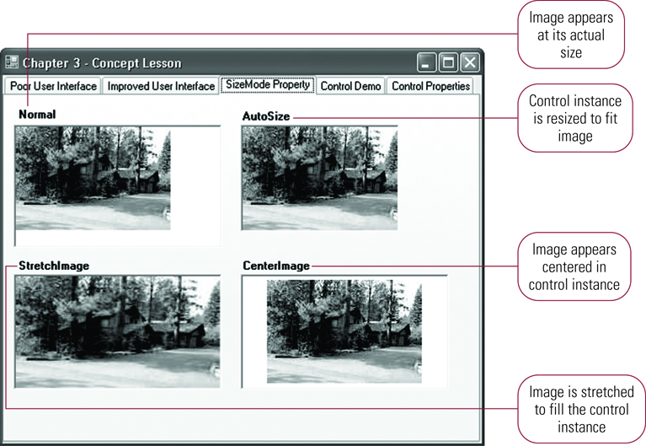
Using the SizeMode Property to Scale Images

Slide 17
The OpenFileDialog Control (Optional)
The CommonDialog class is the base class for other classes
These classes are used to display standard dialog boxes
The OpenFileDialog control allows the end user to select a file to open
Not a database, but a file such as a linear or sequential file
The control instance appears in a resizable tray below the Windows Forms Designer at design time
Call the ShowDialog method to display the control instance →

Slide 18
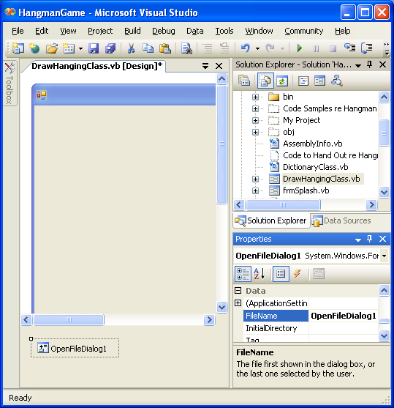
OpenDialog Illustration (VB) (Optional)

Slide 19
Using the OpenFileDialog Control (Optional)
The ShowDialog method displays the dialog box to the end user
The FileName property contains the file name selected by the end user
The OpenFileDialog control does not actually open a file
You need to do this
You can find the OpenFileDialog control in the dialogs section of your toolbox – just click twice on the Toolbox icon to insert the box into your form
Click twice on the inserted box to get the control event handler

Slide 20
The OpenFileDialog Control (Example-Optional)
Display an instance of the OpenFileDialog control named ofdImages, and print the filename selected by the end user
ofdImages.ShowDialog()
System.Console.WriteLine(ofdImages.FileName)
Here is another example →

Slide 21
The OpenFileDialog Control (VB) (Optional) (VB Example - See if you can convert this to C# -- if you need help, ask!!)
1/2/2016 4:57 PM

Slide 22
The OpenFileDialog Control (VB Example) (Optional)
1/2/2016 4:57 PM

Slide 23
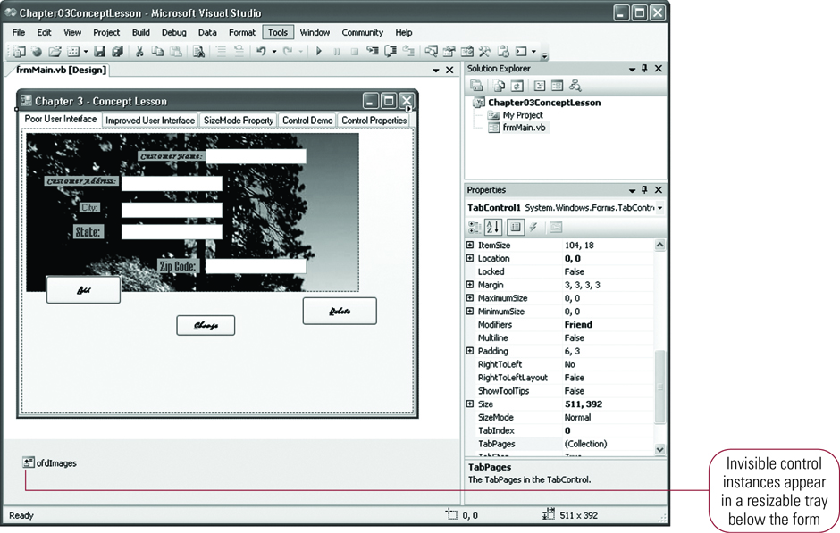
Invisible Control Instance (optional)

Slide 24
ToolTips (Introduction)
ToolTips appear as pop-up windows when the mouse hovers over a control instance
Use to display informational messages to the end user
Create ToolTips with the ToolTip control
The ToolTip control is a provider control, meaning that it works with other control instances
Use one ToolTip control instance for all the other control instances on a form

Slide 25
ToolTip Control (Members)
InitialDelay property controls the amount of time the mouse must hover before displaying the ToolTip
AutomaticDelay property controls the length of time the ToolTip appears
Use to ToolTipOnControlInstanceName to display the ToolTip

Slide 26
Creating Code for a Windows Application
Code executes as the end user interacts with the form’s control instances
This code is called the code behind the form
The code behind the form is made up of two parts
One part is automatically generated by the Windows Forms Designer
The second part contains the code you write

Slide 27
Introduction to Class Blocks
A form is made up of two files
The Windows Forms Designer generated code appears in the file named frmName.Designer.vb
It is good to be able to read some of this code, but we will focus only on some portions of this code and not others
Developer created code appears in the file frmName.vb
A form is a class having the following structure
public partial class frmSplashStart : Form
{
// form block of statements
} // end Class frmSplashStart

Slide 28
A Class (Example)
// Current File Class
// Data stores and method related to the Current File processed by the project
// Frank Friedman
// CIS 3309
// Adapted from VB Version 1 - Feb 6 2010 by FLF July 18, 2013
using System;
using System.Collections.Generic;
. . .
using System.Windows.Forms;
namespace ATM_Simulation_Project_CSharp
{
public class currentFileClass
{
private string currentFilePath;
private System.IO.StreamReader currentFileSR;
private int recordReadCount;
// Constructor with file path input
// Create instance of StreamReader class (type) and store reference
public currentFileClass
(string filePath)
. . .
} // end currentFileClass
} // end namespace

Slide 29
The Syntax of a Class Block
All classes belong to a Namespace
Classes have a header and are delimited with braces { }
A C# Class block contains:
Methods (written as functions)
Attributes (class variables – declared outside any method)
A class constructor is the entry point
The constructor’s header contains only the words public and the name of the class itself

Slide 30
A (Partial) Class Associated with a Form
If a (partial) class is associated with a form your code behind goes in the form’s .cs file
The associated (generated) partial class can be found in the forms …designer.cs file
See next three slides → →

Slide 31
Your Partial Class for a Form

Slide 32
Windows Forms Designer Generated Code

Slide 33
More Generated Code
The next slide contains code that is generated for controls added to a Form
Object instantiation code appears first
Definitions of default attributes (properties) appear next – but only shown for
lblWelcome
lblToThe

Slide 34
Forms Designer Generated Code - 2

Slide 35
Introduction to Event Handlers - 1
We are now operating in an event driven programming environment.
Compare to a standard C (and Java in 1068 and 2168)
An event hander is a procedure containing statements that execute when the end user performs an action. Activity happens when an event is fired.
Windows executes different event handlers as different events fire
Windows fires a Click event when the end user clicks a button
Different types of controls support different events

Slide 36
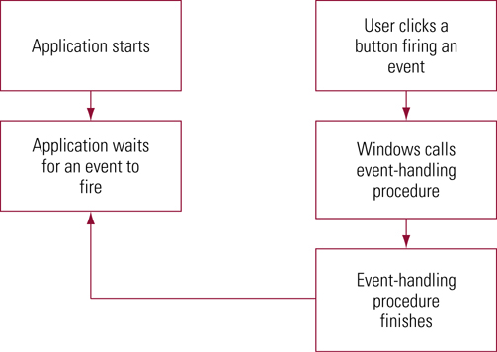
Executing an Event Handler

Slide 37
Characteristics of an Event Handler
An event handler is a void function
All event functions have two arguments
Arguments send information to a procedure
More on these in a later slide set
The Handles clause (found in the Designer.cs code) wires the function to the event
this.btnFindMe.Click += new System.EventHandler(this.btnFindMe_Click);
Above wiring code generated automatically in the Windows Forms Designer

Slide 38
Event Handlers - 2
The handler itself can be generated by double-clicking the control instance in the Windows Forms Designer.
You get the default event wired to the control→
To see a list of additional handlers that can be wired to an event click on the lightening bolt icon in the Properties window for the control at hand → →
You can create custom handlers for events (See textbook, pp. 174-175)

Slide 39
Event Handlers - 3

Slide 40
List of Events for a Button Control

