Slide 1
Lecture Set 4
Data Types and Variables
Part A – Introduction
Numeric Data Types

Slide 2
Objectives
Understand the CTS and CLS
Understand how to declare and process numeric data
Declare and use variables
Create user-defined constants and use expressions
Work with intrinsic functions and methods

Slide 3
Expectations
Most of this material should be old hat from CIS 1068 and 2168
I will try to cover added material not covered in the book and concepts that may be difficult or new
For the most part, I once again expect you to read the book and come to class with questions

Slide 4
Introduction to Data Types and Data Storage
Every object and property has a data type
Data types that store numbers are called numeric data types
Numeric data types can be divided into two categories
Some numeric data have a decimal point
Some numeric data types store integral values (values without a decimal point)

Slide 5
What is a Data Type (in .NET)?
The Common Type System (CTS) is a core piece of the .NET Framework architecture – part of the Common Language Infrastructure (and hence of the CLR)
The CTS and CLS are like a standard that must be conformed to by all .NET languages
What does this mean? What is a standard? Why do we have them?
Types defined within this Framework are used by all .NET languages and are called managed types
A Managed Type is a type that conforms to a set of rules set for the in the CTS – we use only Managed Types in our code

Slide 6
The Role of the CTS
Managed Types are the key to the interoperability of programming languages in .NET – to our ability to mix and match programming languages in .NET
If each language is allowed to define its own type system, interoperability is impossible
The CTS: backbone of the .NET programming model
Core set of system defined types
The rules for creating user defined types
Every managed language such as VB, C#, J#, COBOL, C++ in the .NET Framework sits on top the same underlying programming model and type system
Types that are not compilable into a CTS type cannot be used except internally within a given component
That is – they are not useable by “outside” components – those not developed in the same Assembly

Slide 7
Common Language Specification (CLS)
The CTS is part of a broader Common Language Specification or CLS
The CLS defines the subset of types and other language features that must be supported across all managed languages – it levels the playing field across languages.
Every issue of incompatibility from one language to another has to be addressed in the CLS. Examples:
Three unsigned integer types are supported by C# but not VB .NET.
Case sensitivity (getName vs GetName are different (method) names in C#; they are treated the same in VB .NET)

Slide 8
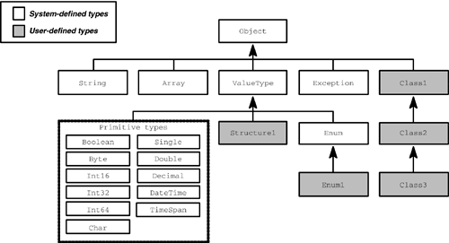
Data Types – The Type Inheritance Hierarchy
The CTS is based on a singly rooted inheritance hierarchy (Pattison).

Slide 9
CTS Compliant Primitive Types (Pattison)

Slide 10
Primitive Types (aka Built-In Types)
Primitive may be a bad choice of terms
Often implies non-class based types
Not so in .NET
These are class-based types which have numerous shared methods and data stores
Examples:
(int)MinValue Casting example
Double.Parse(s2) ‘Converts string to double
ToDouble(myInteger)
salesAsDecimal = Decimal.Parse(salesAsString)
DateTime primitive

Slide 11
Integral Data Types
Integral data types store data that does not have a decimal point
Some integral data types can store 0 or positive values
Other integral data types can store both positive and negative values (and zero)
Negative values are indicated by a sign bit
Unsigned data types are new to Visual Studio as of 2005

Slide 12
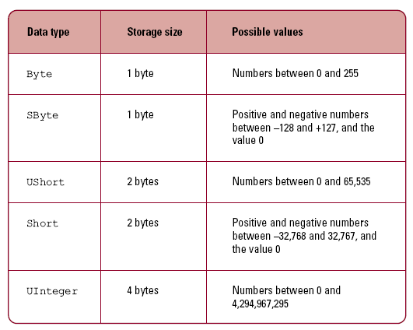
Integral Data Types

Slide 13
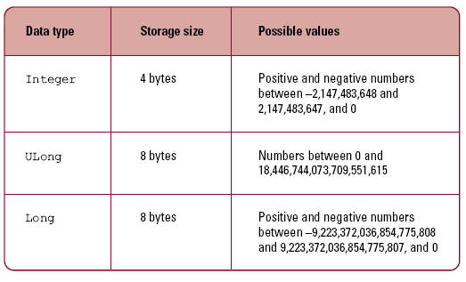
Integral Data Types (continued)

Slide 14
Understanding Integral Data Types
All integral values are stored as binary numbers
The SByte data type stores its data in 8 bits
7 bits store the data
1 bit stores the value's sign
The largest possible value is 2^7-1 or 127
The value has the binary pattern 01111111

Slide 15
Understanding Integral Data Types (continued)
Negative integral values appear in two’s compliment format
Rules to represent a negative two’s compliment value:
Start with the binary representation of a positive number
Flip each bit
0 values become 1
1 values become 0
Add one to the number produced in the previous step

Slide 16
Negative Two’s Complement Value
Start with the positive representation of a value (What is this value?)
0010 1010
Flip each bit
1101 0101
Add one to the value from the previous step
1101 0110

Slide 17
Introduction to Floating-point Data Types
Floating-point numbers store values with a decimal point
Floating-point numbers are stored in a form of scientific notation
One bit is the sign bit
A 23-bit mantissa stores the fractional part of a number
The characteristic (like an exponent) is stored in 8 bits using excess notation (never negative)
Other peculiarities – assumed decimal point; normalized representation

Slide 18
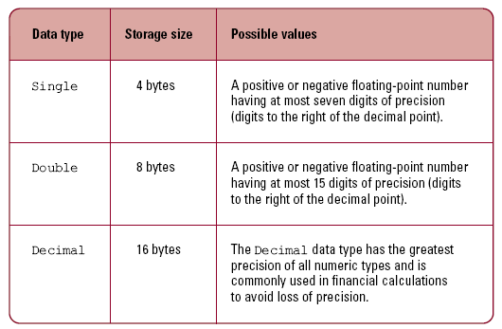
Floating-point Data Types

Slide 19
Representation of a 32-bit Single Precision Value (optional)

Slide 20
A Brief Note on Decimal Values (optional)
Values stored as being of the decimal data type consist of 128 bits.
The format of decimal value is a bit peculiar. (In other words, exactly how the 128 bit are used is a little different.)
There is a 32 scaling factor the essentially indicates where the decimal point is in the in the integer.
What this gives you is approximately 28 decimal digits of information. As a rough computation, there is a shade more than 3 bits per decimal).
signed integer value | scale factor

Slide 21
More on the Decimal Type
The Decimal Type is almost perfect for storing (modeling) money. The decimal "slides."
If you need 8 decimal digits to the right of the decimal you have 20 remaining to use on the left. The scale factor is used to determine where the decimal is in the value stored.
This is more efficient than using decimal strings and it is pretty accurate for modeling money since you have 26 decimal digits to the left of the decimal.

Slide 22
Floating Point Data – Error Analysis
It’s a big deal …
We model almost all information we manipulate using the computer
The models are imprecise – this lack of precision has many causes
Finite number of bits for the model
We use base 2 values, not base 10 – some base 10 values cannot be precisely modeled in base 2
One thin dime for example 0.10
Try getting a precise representation in base 2

Slide 23
Rounding Error (Introduction)
Floating-point numbers are an approximation of an actual value
1/3 or 2/3 must be rounded, for example
Rounding introduces an error called rounding error
The greater the precision of the data type, the smaller the rounding error
The Decimal data type has the smallest rounding error and the greatest precision (around 28 decimal digits)
The currency type is not supported in C#

Slide 24
Properties of Numeric Data Types
Numeric data types have constant fields that store the minimum and maximum possible values for the data type
MinValue stores the minimum possible value
MaxValue stores the maximum possible value

Slide 25
Performance of Numeric Data Types
Performance is a key characteristic of any application
Different data types have different performance characteristics
Arithmetic operations using integral data types are faster than operations on floating-point data types
The Decimal data type is very slow

