Slide 1
Lecture Set 4
Data Types and Variables
Part B – Variables, Constants, Expressions Conversion Rules
Options Strict, Option Explicit
Scope of Definition

Slide 2
Objectives
Declare and use variables
Create user-defined constants and use expressions
Understand type conversion in C#
How to avoid trouble and get maximum protection (from yourself)

Slide 3
Introduction to Variables
A variable stores data while an application runs
The process of creating a variable is called declaring a variable
A variable has a name (identifier)
The naming rules for variables and procedures are the same
A variable has a data type

Slide 4
Variable Characteristics
All variables have three characteristics
A variable has a lifetime
A variable has a scope
A variable has accessibility
Consider a simple example from a previous Chapter 4 lecture →

Slide 5
Variable Characteristics - Illustration
public class counterType
{
// This is a class variable
// (aka a global variable or class data store or property)
private int value; // Scope? Lifetime? Accessibility?
// *** Constructor – initialize counter (value) to argument value
public counterType (int initialValue)
{
. . .
} // end constructor
public void increment()
{
value = value + 1;
} // end Increment
} // end Class counterType
…
// Code appearing elsewhere …
// This may be assumed to appear in some function or procedure.
// It is a local variable. Scope? Lifetime? Accessibility?
counterType myCounter; // What does this do?
myCounter = new counterType(0); // What does this do? Draw picture!

Slide 6
Variable Lifetime
Variable lifetime refers to the period of time that a variable exists
A variable declared locally within a function exists only while a function executes
A variable declared within a class (or module) exists while a class instance exists or a module is loaded
You may remember such variables as class members or class data stores or variables global to a class

Slide 7
Variable Scope and Accessibility
Variable scope refers to the statements that can use a variable
Variables declared inside a function have local scope (no relevance or accessibility outside the function)
Variables declared outside a function with the private statement have module-level or class-level scope – that is, they are global (accessible) to all the methods in the class.

Slide 8
Declaring a Local Variable
Local means local to a function
Type [Static] varname [=initexpr]
Declares a local variable
The variable is created when the containing function is invoked
The variable and any value it might have is destroyed when execution of the containing function ends
The Static keyword declares a local variable
The variable and its value persist from one function invocation to the next
varname contains the name (identifier) of the variable
Type defines the variable’s data type
initexpr is used to initialize the variable’s value

Slide 9
Initializing Variables
Variables can be declared and initialized in the same statement
Example to declare a variable named CurrentYear and initialize its value to 2006:
int currentYear = 2006;

Slide 10
Common Initialization Errors
Numeric initialization values cannot contain formatting characters
The following statements are illegal:
double value1 = 100,000.52;
double value2 = $100,000.52;

Slide 11
Variable Naming Conventions
A scheme of naming variables is called a naming convention
Naming conventions improve a program’s readability
Common naming conventions
Hungarian notation
Pascal case
Camel case

Slide 12
Naming Conventions (Description)
Hungarian notation
Use a prefix to denote the data type followed by a descriptive name
Pascal case
Use whole words
Capitalize the first letter of each word
Camel case
Use whole words
Use lower case for the first letter of the first word
Capitalize the first letter of each remaining word
Capitalize all words (entire words) for named constants
I generally use a combination of Hungarian and Camel notations

Slide 13
User-defined (named) Constants
Named constants are similar to variables
The value of a constant does not change while an application runs
Trying to assign a value to a constant during execution will cause an error
Use the const statement to declare a constant
const int DAYSINMAY = 31;
Constants are typically declared at the class level
Why bother with this? City Wage Tax? Y2K?

Slide 14
User-defined Constant (Example)
Declare a constant to store value of PI
private const int PIVALUE = 3.14159; Declare a constant to store the value of PI multiplied by 2
private const int PIVALUE = PIVALUE * 2;

Slide 15
Introduction to Expressions
Variables can be used in assignment statements along with object properties
Examples:
int result;
int example = 4;
result = 3;
result = txtExample.Height;
result = example;

Slide 16
Common Expression Errors
Values on the right and left sides of an assignment statement normally should have the same data type
The Font and Integer data types are not compatible so the following statements will cause an error:
int someInteger;
someInteger = txtExample.Font

Slide 17
Parts of an Expression
Operators
Arithmetic operators such as (+, -, *, /, %)
Comparison and logical operators
Operands
Literal values
Object properties
Constants
Variables

Slide 18
Operator Precedence
Operators have an evaluation order called precedence
The C# precedence rules are the same as the algebraic precedence rules
Use parentheses to override the default precedence rules
Use parentheses to clarify evaluation order
Extra parentheses do no harm

Slide 19
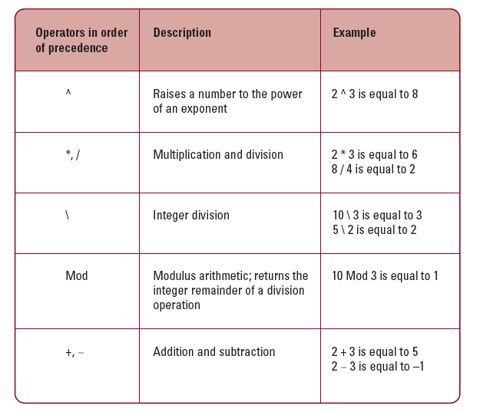
Operators and Precedence (VB)

Slide 20
Arithmetic Operators (Example)
C# has no special integer division operator
Divide 10 by 5 and multiply the intermediate result by 100
The value 200 is stored in Result
double numerator = 10;
double denominator = 5;
double result;
result = numerator / denominator * 100;
What is the value of result?

Slide 21
The Mod Operator
The Mod operator calculates the Integer remainder of a division operation
The operation is the same as the remainder resulting from a long division operation
Examples:
result = 5 % 2; // = 1
result = 4 % 2; // = 0

Slide 22
Operator Precedence
Arithmetic operators are applied in a default order known as precedence
Multiplication and division, addition and subtraction
Use parentheses to change the default precedence order
C# has no exponentiation operator ^

Slide 23
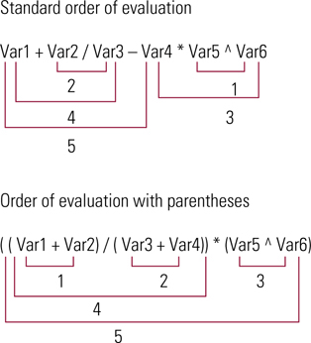
Evaluation Order with and without Parenthesis

Slide 24
Data Types and Type Conversion
Type conversion or casting is used to convert data from one data type to another
There are two types of conversions
Narrowing conversions: the receiving variable is not “wide enough” to receive all the information associated with the course variable
Widening conversions: the receiving variable is wide enough …
Example: Converting type double to an integer is a narrowing conversion. The opposite (integer to double) is a widening conversion

Slide 25
Widening and Narrowing Conversions
Implicit casting is often done by C# where widening is concerned. Not so with narrowing conversions.
A given type will not be implicitly converted to a more restrictive type (in other words, narrowing will not be allowed unless you do so explicitly)
Strings will not be implicitly converted to numeric data types
Lots of other conversions are prohibited

Slide 26
Strict Type Checking Rules
Narrowing versus Widening type coercion is the key – widening allows more restrictive types to be implicitly converted to less restrictive types
Integral data types will be converted to floating-point types
Single to Double is legal
Double to Integer is not legal

Slide 27
Conversion – Primitive Types (VB) (Pattison)

Slide 28
Performing Explicit Type Conversion (brief)
Almost ALWAYS a good idea
Use casting operators such as (int), (double) …
OR, use members of the System.Convert class to explicitly convert data from one type to another
Methods exist for each primary data type
Example:
double doubleValue = 123.44;
int integerResult;
integerResult = System.Convert.ToInt32(doubleValue);
integerResult = (int) doubleValue;

Slide 29
Explicit Type Conversion Methods
ToInt16, ToInt32, and ToInt64 convert the argument to an integral value
ToDecimal converts the argument to the Decimal data type
ToDouble and ToSingle convert the argument to floating-point data types
ToString converts the argument to a string
As we will see later in Lecture Set 4 notes, this can be really useful
Note that these methods do no rounding and hence can lead to Format Exceptions (discussed later)

