Slide 1
Lecture Set 5
Control Structures
Part B - Message and Input Boxes

Slide 2
Objectives
Learn how to create and use to your advantage message boxes and input boxes
1/3/2016 8:48 PM

Slide 3
The MessageBox Class
The MessageBox is a standard dialog box that displays
A message
A caption
An icon
One or more standard button groups
This is extremely handy for software-user communication and for debugging purposes
1/3/2016 8:48 PM

Slide 4
The MessageBox Show Method (Syntax)
public shared DialogResult show
(string text,
string caption,
messageBoxButtons buttons,
messageBoxIcon icon);
text appears in the title bar of the MessageBox
caption contains the message
buttons defines the button(s) to go in the box
icon defines the icon to go in the box
(See next few slides for more details)
1/3/2016 8:48 PM

Slide 5
The MessageBox.Show Method (Example)
Display a message box with Yes and No buttons
DialogResult result;
result = MessageBox.Show(
"Do you want to quit?", "Exit", _
MessageBoxButtons.YesNo, _
MessageBoxIcon.Question)
if (result = DialogResult.Yes)
{
this.Close()
} // end if
1/3/2016 8:48 PM

Slide 6
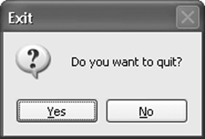
Message Box
1/3/2016 8:48 PM

Slide 7
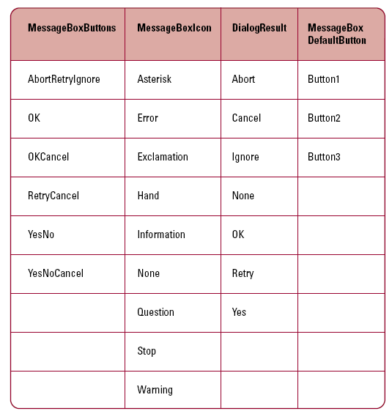
Message Box Enumerations
1/3/2016 8:48 PM

Slide 8
The InputBox (Introduction -Optional)
The InputBox gets a text string from the end user
It's a standard dialog box
It is possible to supply a default textual value
1/3/2016 8:48 PM

Slide 9
The InputBox (VB Syntax - optional)
Shared Function InputBox _
(ByVal prompt As String, _
Optional ByVal title As String, _
Optional ByVal defaultResponse As String, _
Optional ByVal xPos As Integer, _
Optional ByVal yPos As Integer) _
As String
prompt contains a descriptive prompt
title appears on the title bar
defaultResponse contains the default value
xPos and YPos contain the coordinate values where the input box will appear
1/3/2016 8:48 PM

Slide 10
The InputBox (VB Example - optional)
Display an input box and store the returned string in ResultString
Declares a string variable to store a string entered by the user and returned by the InputBox method
Dim ResultString As String
ResultString = _
Microsoft.VisualBasic.InputBox( _
"Enter a value", "Title", _
"Default Value", 0, 0)
1/3/2016 8:48 PM

Slide 11
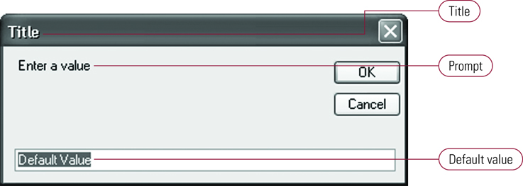
Input Box (optional)
1/3/2016 8:48 PM

