Slide 1
Lecture Set 6
The String and DateTime Data Types
Part A – The DateTime Type

Slide 2
Objectives
Understand the basics of using dates
Representation of DateTime data type (Data Stores)
Operations (Methods) on the DateTime type
DateTime conversions especially with respect to strings
Work with the System.DateTime data type
Perform arithmetic operations on dates
Use the DateTimePicker control as a means for the end user to select dates from a calendar
Use the Timer control to generate events at regular intervals
8/8/2013 1:12 PM

Slide 3
Introduction
The System.DateTime data type is used with dates
Two problems must be solved when working with dates
Every calendar must define the "beginning of time" called the epoch
Every calendar must increment time somehow
8/8/2013 1:12 PM

Slide 4
The Epoch
Different computer systems represent the beginning of time differently
UNIX uses January 1, 1970 as the beginning of time – find out why
Windows uses January 1, 0001 as the epoch
This makes it easy to perform arithmetic on dates and times
8/8/2013 1:12 PM

Slide 5
Representing a Point in Time
Using the Gregorian calendar, time is incremented daily
Using fractional parts of a day is referred to as timekeeping
In UNIX, time is incremented in milliseconds
Windows increments time in 100 nanosecond units called ticks –
nanosecond vs millisecond ??
8/8/2013 1:12 PM

Slide 6
The System.DateTime Data Type
The DateTime data type is a structure, so it is a value type
But we can also apply new to a DateTime structure in which case we get a boxed structure -- an object
The DateTime data type has methods to perform operations on dates and times
The syntax to declare a DateTime structure is the same as the syntax to declare any other variable
There are no literal date values #12/7/1941#
Create a date time as
pearlHarborDate = new DateTime(1941, 12, 7);
which yields 12/7/1941 12:00 AM
8/8/2013 1:12 PM

Slide 7
See How Parse Works
DateTime.Parse (“Jan 30, 2007 2:15:0 PM”);
Earlier in your reading you saw the Parse method applied to a string formatted as a decimal value
How can this be?
For every data type defined by .NET there are both ToString and Parse methods (one being the “inverse” of the other)
So how do we (how does the compiler) know which version of Parse to use?
8/8/2013 1:12 PM

Slide 8
Declaring a DateTime Variable (Example)
The following statements declare and initialize variables having the DateTime data type:
DateTime CurrentDate;
DateTime PastDate, FutureDate;
DateTime InitializedDate = new DateTime(2006,3,10);
DateTime myStart = new DateTime(1942,12,9,15,10,0);
The last statement sets a date time value of 12/9/1942 3:10 PM
8/8/2013 1:12 PM

Slide 9
Members of the DateTime Structure
The MinValue and MaxValue properties store the minimum and maximum possible date values
DateTime MaximumDate = DateTime.MaxValue;
DateTime MinimumDate = DateTime.MinValue;
What are these values? How do you know?
8/8/2013 1:12 PM

Slide 10
DateTime Structure Members (continued)
The Now method gets the current date and time
The Today method gets the current date
The time value is 00:00:00
Examples:
DateTime currentDateAndTime = DateTime.Now;
DateTime CurrentDate = DateTime.Today;
8/8/2013 1:12 PM

Slide 11
DateTime Structure Properties (continued)
The Day, Month, and Year properties (data members) return the day of the month, month of the year, and year …
int month = currentDateTime.Month; // 8 if August
The Hour, Minute, and Second properties return time elements having the same name
The DayOfWeek property returns the day of the week
0 = Sunday and 6 = Saturday
The DayOfYear property returns an Integer containing day of the year
The first day of the year is 1

Slide 12
DateTime Structure Members (continued)
The IsDaylightSavingTime property accepts an argument containing a date
The method returns true if daylight savings time is in effect
The IsLeapYear method accepts one Integer argument containing a year
The method returns true if the year is a leap year
There are other methods as well … how can we find out what they are?

Slide 13
Converting Dates to Strings
The ToString method converts a date to a string
8/27/2006 10:49:48 AM
The ToLongDateString method converts a date to a string using the system's long date format
Sunday, August 27, 2006
The ToLongTimeString method converts a date to a string containing hours, minutes and seconds
10:49:48 AM
The ToShortDateString method converts a date to a string using the system's short date format
8/27/2006

Slide 14
Converting Dates to Strings (continued)
The ToLongTimeString method converts a date to a string using the system's long time format
10:49:48 AM
The ToShortTimeString method converts a date to a string using the system's short time format
10:49 AM

Slide 15
Performing Calculations on Dates
AddHours, AddMintutes, AddSeconds add time intervals to a date
AddYears, AddMonths, AddDays add date intervals to a day
DaysInMonth returns the number of days in a particular month
There are more such methods defined on the DateTime data type

Slide 16
Calculations on Dates (Example)
Call the date arithmetic methods to modify the current date and time
DateTime NextDay = Today.AddDays(1);
DateTime NextMonth = Today.AddMonths(1);
DateTime NextYear = Today.AddYears(1);
DateTime LastDay = Today.AddDays(–1);
DateTime LastMonth = Today.AddMonths(–1);
DateTime LastYear = Today.AddYears(–1);

Slide 17
Introduction to the TimeSpan Structure
The TimeSpan structure represents a time interval in the form
days:hours:minutes:seconds
TimeSpan and int are different data types
The number of whole days, hours, minutes, and seconds in the interval are stored in the Days, Hours, Minutes, and Seconds properties
121 seconds would be 0 Hours 2 Minutes and 1 Second

Slide 18
The TimeSpan Structure (Examples)
DateTime currentdate = DateTime.Today; // 8/8/2013
DateTime startDate = DateTime.Parse(“8/26/2013”);
TimeSpan timeTillDue
= startDate.Subtract(currentDate); // 18:00:00:00
int daysTillDue = timeTillDue.Days; // 18
TimeSpan timeTillDue
= dueDate – currentDate; // 18:00:00:00

Slide 19
The DateTimePicker Control
The DateTimePicker control gives the end user an easy way to select a date using a visual calendar →
Arrows let the user select a month using forward and back arrows at top of calendar
Select a year by first clicking on the year that is showing in the calendar and then using an up-down control to increment or decrement the year
Select a date from the drop-down calendar to set the date and close the calendar

Slide 20
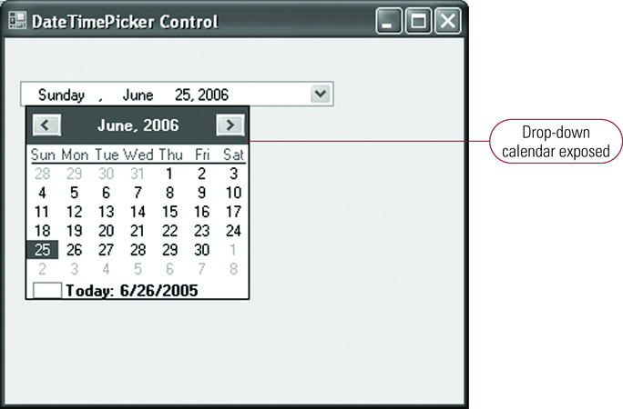
DateTimePicker Control Instance with Calendar Exposed
Note month and year listed at top of calendar (in between the forward and back arrows)
Back arrow
Click on month or year to change
Forward arrow

Slide 21
The DateTimePicker Control (Members)
The Font property defines the font appearing in the control instance
The Format property defines how the data in the control instance appears to the end user
The MaxDate and MinDate properties define the minimum and maximum user selectable dates
The Value property contains the selected date

Slide 22
The Timer Control
The Timer control fires a Tick event at regular intervals (similar to clicking a button but it is automatic for the Timer)
The Interval property defines the timer's interval
The unit of measure is milliseconds
1000 milliseconds is 1 second
The Tick event only fires if the Enabled property is True
The Timer control is not visible at run-time. It shows only on the tray of the forms designer

Slide 23
Timer Control (Example)
Click the Timer Control (small clock icon) in components in the Toolbox to create an instance of it on your form. Name it. Remember that one of its properties is an interval that we can set with code. (See below)

Slide 24
The Timer Control (Example)
Display a simple clock
private void tmrClock_Tick( _ object sender, EventArgs e)
{
lblClock.Text =
DateTime.Now.ToLongTimeString;
} // end tmrClick_Tick

