Slide 1
Lecture Set 6
The String and DateTime Data Types
Part B – Characters and Strings
String Properties and Methods

Slide 2
Objectives
Understand more advanced uses of characters and strings (more than their representations, but lots of methods defined on strings)
Understand character encoding systems and the char data type
Use the String data type
Call members of the String class to manipulate string data
Use strings and dates to create a form letter

Slide 3
Introduction to Character Encodings
The English character set is relatively small
Letters, digits, and a few special characters
International character sets are more complex
German has umlauts
French has grave accents
Many other diacritical marks exist
Some languages have entirely unique character sets

Slide 4
The ASCII Character Set
Early computers used different character sets making data communication between computers difficult or impossible
ASCII was created in 1961 to supply a standard character set shared among computers
An encoding scheme is a way of uniquely representing every character in a language with a unique binary value
ASCII is but one encoding scheme

Slide 5
The Unicode Character Set
ASCII cannot effectively represent the characters of international languages
Unicode (“Unification code”) is an international character set, which stores a character in an unsigned 2-byte value
Each unique character is called a code point
65,536 characters (code points) are possible
The first 128 code points store ASCII characters
The second 128 code points store special characters
The remaining code points store symbols and diacritical marks
Unicode allows us to represent multi-lingual character encoding systems

Slide 6
Introduction to the char Data Type
The char data type stores a single Unicode character in one 16-bit (2-byte) value
The same syntax is used to declare a char as any other data type
char is a primitive data type
char and string are not the same
char c = “A”; // conversion error
string s = ‘A’; // conversion error

Slide 7
Conversions to the Char Data Type
The System.Convert.ToChar method converts a String or an Integer to a Char
The Integer value corresponds to the Unicode code point
For example, the letter “A” has an integer value 65. What is the value of “Z”; of “0”; of “@”?
Examples:
LetterA = System.Convert.ToChar(65);
LetterA = System.Convert.ToChar("A");
In these examples the result is the storing of the Unicode character A in the variable LetterA
How is this handled in Java?

Slide 8
More on the String Data Type
A string is a class with an indexer [index], a length property and lots of methods (see text for details)
NOTE: Strings created from the string class are immutable
That is they are of fixed length and value
If you reassign a string value to a string variable, the original string is deallocated and a new one is created
The Text property of a TextBox stores a string, for example
The String data type is a reference type

Slide 9
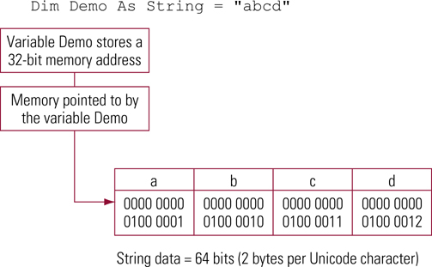
Storing Data in a String (VB)

Slide 10
Declaring a string
The syntax to declare a string is the same as the syntax to declare any other variable
Multiple variables can be declared in the same statement
Double quotation marks surround literal initialization values

Slide 11
Declaring a string (Example)
Declare and initialize variables having a data type of String
private string prefix;
private string firstName, lastName;
private string currentName = "Joe Smith“;

Slide 12
Strings and Assignment Statements
Strings can be assigned just as numeric variables can be assigned
Double quotation marks surround literal values
The data types of both sides of an assignment statement must be the same
Examples:
string personName;
string currentName = "Joe Smith“;
personName = currentName;
personName = txtName.Text;

Slide 13
Strings and Type Conversion
Numeric data must often be converted to a String
Call the ToString method on any data type to convert a value to a string
For numeric data types, a format specifier can be passed as an argument
Example to convert a value and format it as currency:
double dataValue = 1234.56;
string formattedOutputValue;
formattedOutputValue
= dataValue.ToString("C"); // Currency

Slide 14
Converting Strings to Numeric Types
The methods of the System.Convert class convert strings to numeric data types
An exception will occur if the value cannot be converted
Example to convert the Text property of a text box:
int integerDataValue;
float floatDataValue;
integerDataValue =
System.Convert.ToInt32(txtInput.Text);
floatDataValue =
System.Convert.ToFloat(txtInput.Text);

Slide 15
String Operations
Strings can be appended together (concatenated)
The plus (+) operator is the concatenation operator
Example:
string firstName = "John“;
string lastName = "Brown“;
string fullName;
fullName = firstName + " " + LastName;

Slide 16
Using Control Characters (Example)
Embed a carriage return in a string
The string John and Brown will appear on separate lines
txtOutput.Text = "John" + “\n” + "Brown“;

Slide 17
Working with Multiline Text Boxes
Text appears on multiple lines when the MultiLine property is set to True
Scroll bars appear based on the following settings for the ScrollBars textbox property:
None – no scroll bars appear
Horizontal – a horizontal scroll bar appears across the bottom of the text box
Vertical – a vertical scroll bar appears along the right side of the text box
The WordWrap property defines whether lines wrap on word boundaries

Slide 18
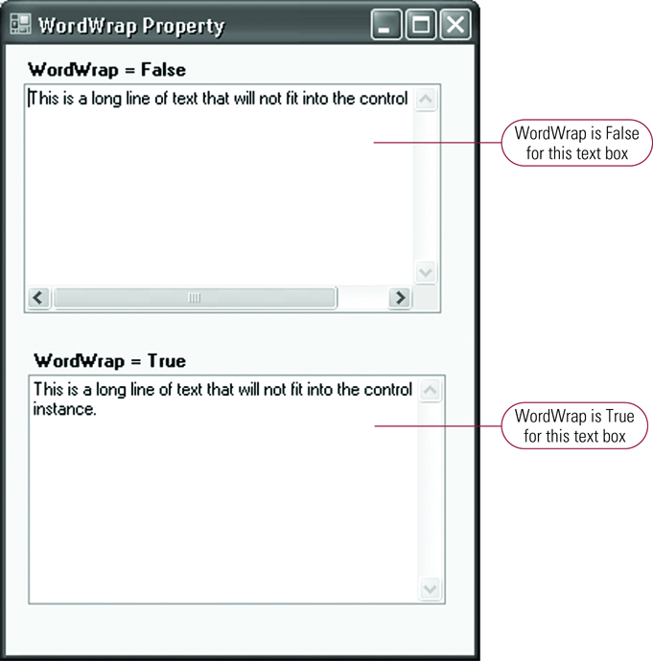
Effect of the WordWrap Property

Slide 19
String Manipulation Methods (Introduction)
Determine the length of a string (Length)
Convert the case of a string (ToUpper, ToLower)
Work with parts of a string (IndexOf, Substring, Insert, Remove, Replace)
Delete leading and trailing spaces (Trim)
Some of these are a bit tricky to use – you have to read the interface descriptions in the text carefully

Slide 20
Determining Length of a String (Length)
The Length method of the String class returns the length of a string
The method is one-based so a string with one character has a length of one
An empty string has a length of zero
Example (The string is 14 characters long):
string fullName = "Mr. Ed (Jones)“;
string lengthOfString;
lengthOfString = fullName.Length();

Slide 21
Converting the Case of a String (ToUpper, ToLower)
The ToUpper method converts all characters to upper case
The ToLower method converts all characters to lower case

Slide 22
Converting the Case of a String (Example)
string currentString = "John Brown“;
string upperString, LowerString;
upperString = currentString.ToUpper();
lowerString = currentString.ToLower();
Example Output:
JOHN BROWN
john brown

Slide 23
The IndexOf Method (Syntax)
Powerful, but tricky
Headers …
public int IndexOf(string value)
public int IndexOf(string value, int startIndex)
public int IndexOf
(string value, int startIndex, int count)

Slide 24
The IndexOf Method (Syntax, continued)
The IndexOf method searches for a substring within a string
The method returns the character position of the first character in the string where the substring was found
The method returns -1 if the substring was not found
The first argument named value contains the substring
The optional second argument contains the starting position in the string where the search begins
The optional third argument contains the number of characters to search

Slide 25
The IndexOf Method (Examples)
Search for a substring within a string
int position;
string states = "Arizona California Nevada“;
position = states.IndexOf("California") // 8
position = states.IndexOf("California", 10) // –1
position = states.IndexOf("Arizona", 0 , 5) // –1

Slide 26
The Substring Method (Syntax)
The Substring method selects one or more characters from a string
public string Substring(int startIndex)
public string Substring(int startIndex, int length)
The startIndex argument contains the character position where searching will begin
The length argument contains the number of characters to search
How can we have two functions with same name?
How does the compiler tell them apart? What would the Intellisense descriptions look like?

Slide 27
The Substring Method (Example)
Select the numeric parts of a Social Security number
string SSN = "555-12-3456“;
string Part1, Part2, Part3;
Part1 = SSN.Substring(0, 3); // 555
Part2 = SSN.Substring(4, 2); // 12
Part3 = SSN.Substring(7, 4); // 3456

Slide 28
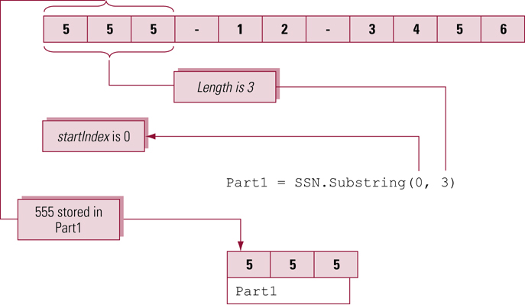
Operation of the Substring Method

Slide 29
The Insert Method (Syntax)
The Insert method inserts one string into another string
public string Insert(int startIndex,
string value)
The startIndex argument contains the character position in the existing string where the new string will be inserted
The value is 0-based
value contains the string to be inserted

Slide 30
The Insert Method (Example)
Insert dashes into a Social Security number
string SSN = "590123456“;
SSN = SSN.Insert(5, "-");
SSN = SSN.Insert(3, "-");

Slide 31
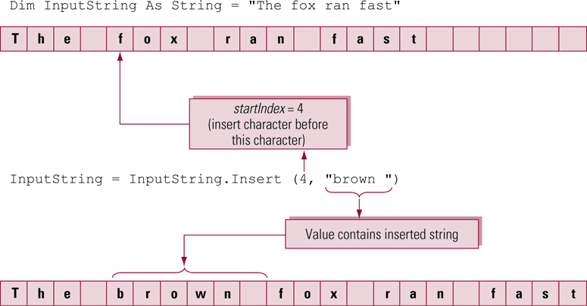
Operation of the Insert Method

Slide 32
The Remove Method
The Remove method deletes one or more characters from a string
public string Remove(int startIndex);
public string Remove(int startIndex, int count);
The first method removes all characters from startIndex to the end of the string
The second method removes count characters starting at startIndex

Slide 33
The Remove Method (Example)
Remove the area code from a telephone number
string Telephone = "702-555-1212“;
string TelephoneNoAreaCode;
TelephoneNoAreaCode = Telephone.Remove(0, 4);

Slide 34
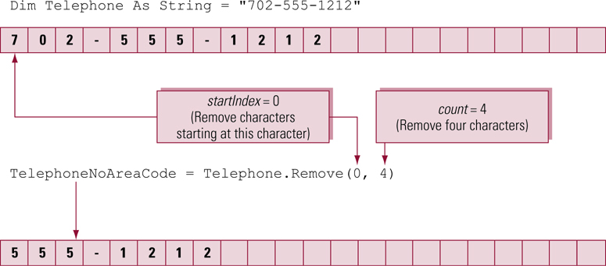
Operation of the Remove Method

Slide 35
The Replace Method
The Replace method replaces one character with another character or one string pattern with another string pattern
public string Replace(char oldChar, char newChar);
public string Replace(string oldVal, string newVal)
In the first method, the character in oldChar is replaced by newChar
In the second method, the string in oldVal is replaced by the string in newVal

Slide 36
The Replace Method (Example)
Replace a space with no character (nothing)
string inputString As String = "A B C D E“;
inputString = inputString.Replace(" ", "");

