Slide 1
Lecture Set 8
Validating Data and Handling Exceptions
Part A – Doing Your Own Input Validation with Simple VB Tools

Slide 2
Objectives
Understand the importance of input validation in software systems
Learning about .NET (Managed Language) tools and type check functions useful to input validation
Use decision-making statements to perform input validation
Given a form that uses text boxes to accept data and the validation specifications for that data, write code that validates the user entries.

Slide 3
Decision-making and Input Validation - 1
Input validation is used to check input to make sure it is valid or at least plausible
Input validation is one of THE most important issues for all systems designers
It is no less important for the design of interactive software systems (such as e-commerce, games, data storage and mining, and other web-based systems)
Prevention is the key – we need to be sure our systems are protected from user error

Slide 4
Decision-making and Input Validation - 2
Visual Studio provides many tools that can greatly simplify the input validation task
Various types of buttons
“Collection Controls” which provide a limited but possibly wide variety of options from the user to choose from
Scrollable menus – e.g., SW Airlines departure cities
Pull down menus – e.g. what state you live in
Checkboxes
The DateTime picker from Chapter 5
But there is no substitute for carefully planning
You need to learn how and when to use these controls
You always need a clear understanding (from the client’s point of view) of what is valid (or plausible) and what is not

Slide 5
.NET C# Validation Tools
C# does not have the handy type validation functions such as IsDate or IsNumeric that VB has
You therefore have to either write your own OR use safe conversions to avoid exceptions
Use the method to determine whether a string can be converted to a date
Use the method to determine whether a string can be converted to a number, or a decimal, etc
These methods return True if the value can be converted and False otherwise

Slide 6
Using IsNumeric for Data Validation

Slide 7
Rolling Your Own Validation Code
Check out pages 202 and 203 in your text
Code is there for validations such as
Reuse this code!! IsDecimal
IsPresent
IsWithinRange
The combination of the above

Slide 8
Using Regular Expressions for Data Validation
Regular expressions can also be used for numeric validation.
The downside is that you need to understand how to write the regular expressions.
Here is an example.
// Matching a string that contains all numbers plus an
// equals sign like
Regex regex = new Regex("^[0-9]+$");
if (regex.IsMatch(compare)) { //true }

Slide 9
The MessageBox Class
The MessageBox is a standard dialog box that displays
A message
A caption
An icon
One or more standard button groups
This is extremely handy for software-user communication and for debugging purposes

Slide 10
The MessageBox Show Method (Syntax)
public shared DialogResult Show(
string text, string caption,
MessageBoxButtons buttons,
MessageBoxIcon icon);
text appears in the title bar
caption contains the message
buttons defines the button(s)
icon defines the icon

Slide 11
The MessageBox.Show Method (Example)
Display a message box with Yes and No buttons
DialogResult result;
result = MessageBox.Show(
"Do you want to quit?", "Exit",
MessageBoxButtons.YesNo,
MessageBoxIcon.Question);
if (result == DialogResult.Yes)
{
this.Close();
}

Slide 12
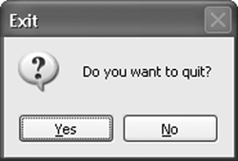
Message Box (sample)

Slide 13
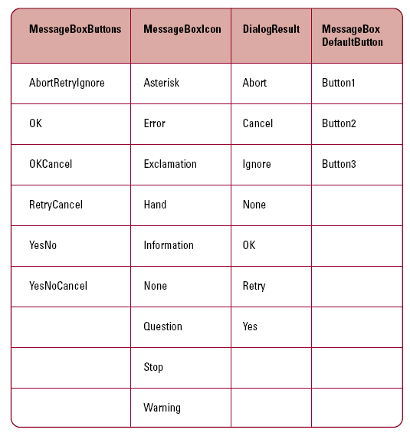
Message Box Enumerations

Slide 14
Input Validation
All these tools still leave plenty for us to do
Learn about the tools and how to choose the best ones
Learn how to protect client (or our own) data stores by ensuring these stores cannot be corrupted by bad data
Learn how to use structured exception handling and, when necessary, our own input validation code in writing our own validation software

Slide 15
Decision-making and Input Validation Guidelines -1
Use range checking to determine whether a value falls between a range of values
A person's age, for example
The format of some data can be validated
Social Security numbers
Telephone numbers
Zip codes
Either force the data into the right format or check the format at entry (or both)

Slide 16
Input Validation Events (optional)
Most controls support Validating, Validated, and Enter Events
You can find these in the Events list of the relevant controls
The Enter Event fires when the control gets focus
When you tab to the control or otherwise select it
The Validating event fires just before a control instance loses focus
When you tab to or otherwise select another control
When do we validate input?
When it is entered the first time?
Just before the data us used (in a computation)
Just before a control instance loses focus
The validating event can be canceled
The Validated event does not fire in this case
If the Validating event is not canceled, the Validated event fires. In a real sense – these events fire according to their names.

Slide 17
Input Validation Events (optional)
These are very convenient for structuring the handling of the validation and entry events, but …
They are not all easy to understand
It helps to think a bit about what you would want to happen when validation takes place
When validation fails – let the user try again?
Fire the enter event for the same control again
When validation succeeds – move on
Fire the enter event for the next control

Slide 18
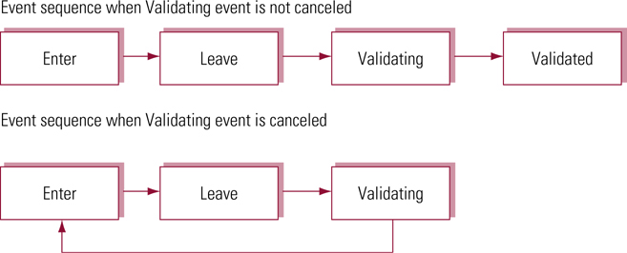
Focus and Validating Event Sequence (optional)
Sequence of steps for a single control …

Slide 19
Validating Event (Example - optional)
Validate a text box and cancel the event if the contents are invalid
If event is cancelled the control’s enter event fires again (so what happens here?)
private void txtDOB_Validating(
object sender,
System.ComponentModel.CancelEventArgs e)
{
if (! IsDate(txtDOB.Text)
e.Cancel = true;
} // end Sub

Slide 20
The Validating Event Example (Explained - optional)
Note the data type of the 2nd argument, e, of the function
This type …
System.ComponentModel.CancelEventArgs
has a property named cancel which when set
to True causes the event to be canceled
In other words, subsequent events would not fire – this current event keeps control giving the user another chance to correct errors
If Cancel is set to False, then subsequent events fire as planned

Slide 21
Moving on …
One of the keys here, which will continue to reoccur is the reliance on data types and objects in understanding how things work
We will not dwell on these events – but you should know they are there and can be very convenient to use

