Slide 1
Lecture Set 8
Validating Data and Handling Exceptions
Part C – Exception Handling with Other VB Tools

Slide 2
Objectives
To understand how to us some additional VB tools in handling exceptions
Masked textboxes
Check boxes
Scrolling tools later to be used with List Boxes and Combo Boxes
8/13/2013 11:40 AM

Slide 3
Using Masked textboxes
Similar to what you can do with a typical database tool
Forces user entries to comply with a specific format
User can’t leave the control until a valid entry has been made (valid in terms of the mask)
Masks are best used with things like dates, phone numbers, zip codes and the like
8/13/2013 11:40 AM

Slide 4
Two Useful Properties of Mask Boxes
The Mask Property –
You set the mask you want to force the format for a given text box
This then becomes a type validation mechanism that you do not have to code
The ValidatingType Property –
The code generated for this control allows you to set this property to a data type such as Date or Decimal to even further restrict what the user is allowed to enter
But YOU have to set the property by writing code to do so
8/13/2013 11:40 AM

Slide 5
You may STILL need to do more work …
You can do this by coding the
TypeValidationComplete
Handler for the control -- -- -- →
8/13/2013 11:40 AM

Slide 6
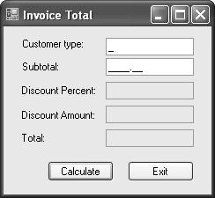
8/13/2013 11:40 AM

Slide 7
8/13/2013 11:40 AM

Slide 8
8/13/2013 11:40 AM

Slide 9
8/13/2013 11:40 AM

Slide 10
8/13/2013 11:40 AM

Slide 11
Are Textboxes a Pain in the Rear?
Validating input is painful in general, and it is even more so when you give the user free reign with regard to data entry (as we do when we use textboxes)
So what do we do?
Start thinking about other controls which the user can use to avoid typing entries
8/13/2013 11:40 AM

Slide 12
Controls that Rely on Decision-Making
Three controls are commonly used with decision-making
The CheckBox control allows the end user to select one of two possible values
The HScrollBar control and VScrollBar controls allow the user to select a value from a range of values
8/13/2013 11:40 AM

Slide 13
The CheckBox Control
The CheckBox control allows the end user to select from two possible values
The CheckAlign property defines where the check box appears
The Boolean Checked property indicates whether the box is checked
The Text property contains the visible text
The TextAlign property controls the alignment of the text
The CheckedChanged event fires when the value of the Checked property changes
8/13/2013 11:40 AM

Slide 14
The CheckBox Control (Example)
Determine whether the CheckBox named chkDemo is checked
if (chkDemo.Checked == true)
txtState.Text = "Checked“;
else
txtState.Text = "Not checked“;
8/13/2013 11:40 AM

Slide 15
The HScrollBar and VScrollBar Controls (Introduction)
Use to select a value from a range of values
The two scroll bars work the same way
The HScrollBar has a horizontal orientation
The VScrollBar has a vertical orientation
8/13/2013 11:40 AM

Slide 16
The HScrollBar and VScrollBar Controls (Syntax)
The Minimum and Maximum properties define the range of values
The current value is stored in the Value property
The SmallChange and LargeChange properties define the magnitude of change
The Scroll event fires while scrolling
The ValueChanged event fires when scrolling is complete and the value changes
8/13/2013 11:40 AM

Slide 17
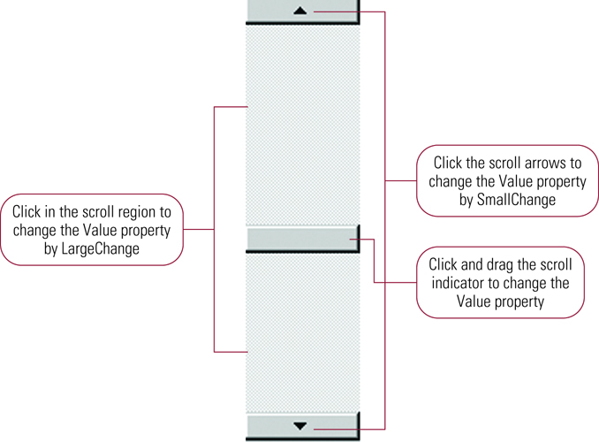
Changing the Value Property of a Vertical Scroll Bar
8/13/2013 11:40 AM

Slide 18
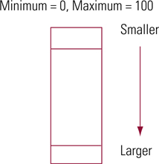
The Maximum and Minimum Properties of a Vertical Scroll Bar
8/13/2013 11:40 AM

Slide 19
Scroll Event (Example)
Display scroll bar values
private void vsbDemo_Scroll( _ object sender, _
System.Windows.Forms.ScrollEventArgs e)
{
txtValue.Text = vsbDemo.Value.ToString;
txtOldValue.Text = e.OldValue.ToString;
txtNewValue.Text = e.NewValue.ToString; } // end vsbDemo
8/13/2013 11:40 AM

