Slide 1
Lecture Set 9
Arrays, Collections and Repetition
Part A – Arrays and Repetition

Slide 2
Objectives
Understand and work with arrays
Particularly – what’s unique about C# arrays
Really – not much compared to Java arrays
More on do loops, while loops and for loops to examine array elements
Much of this should be review – after two semesters of Java it should be easy reading
1/4/2016 9:36 PM

Slide 3
Recap: Where We Have Been and Look Ahead: Where We are Headed
We have now seen and used a number of C# .NET programming tools
Tools designed to help us structure processes as well as data
Repetition structures
Decision structures
Exception handling (try-catch) structures
1/4/2016 9:36 PM

Slide 4
Recap & Look Ahead (continued - 1)
Data
All the built-in data types
int, double, char, etc
Some structured data
Strings, streams, graphing surfaces, collections, data bases (yet to come), forms, other controls
These are all MODELS of problem space entities which carry with them data stores (attributes) and operations (methods) on these stores
In C# we have used classes in building these models
The models are all descendant from the object class
1/4/2016 9:36 PM

Slide 5
Recap & Look Ahead (continued - 2)
In this Lecture Set (9), we take a closer (mostly review) look at two kinds of related collection data structures
Arrays (and their variants)
Lists
We will then move on (in later lecture sets) to take a more thorough look at classes and inheritance and software development using classes as the basic design component
1/4/2016 9:36 PM

Slide 6
Do we need all these structures?
NO!
We can program without any of them, and some people do
However, they do help regularize procedural (logic) control and data patterns which programmers have repeatedly used for decades
It is widely believed that the use of these patterns is helpful in all phases of the development of computer software, including design, programming and testing, debugging, maintenance, etc
And so, we move ahead toward gaining some degree of mastery in understanding and using these patterns
1/4/2016 9:36 PM

Slide 7
Objectives – Introduction to Arrays
Here we introduce the concept of an array
We will see how to declare arrays and how to reference (access) the elements of an array
We will also gain some insights as to how arrays are stored
This may come as a bit of a surprise
Arrays are reference variables (from the array class)
The named variable contains a reference to the base elements of an array, all of which are stored in the heap (illustrated in a later slide)
NOTE: Some of the memory allocation pictures that follow relate to VB but the translation to C# should be relatively easy
1/4/2016 9:36 PM

Slide 8
Characteristics of Arrays
An array stores multiple data items
The elements of an array must have the same data type – called the base type
Or the elements must be of a type derived from the base type
An array can store a list of primary data types or other data types
An array of integers or text boxes, for example
An array has one or more dimensions
A one-dimensional array can be thought of as a list
A two-dimensional array can be thought of as a grid or table (or a “rectangular array”)
A C# array can have between 1 and 60 dimensions
1/4/2016 9:36 PM

Slide 9
Characteristics of Arrays (Declarations)
The number of dimensions in an array is called the rank
A one-dimensional array has a rank of 1
A two-dimensional array has a rank of 2
Each data item stored in an array is called an element
If a size is not specified no elements are allocated
Examples:
int [] table; // Declares an integer array of unspecified size
decimal [0] oneElementArray; // A 1-dimension array of one decimal element
char [] singleArray = new float[4]; // A 1-dimension array of five float data
// The valid subscripts for this array are [0] through [3].
int [,] table; // Two-d array of unspecified size
float [9, 9] table;
int SalesArray[,] = {
{150, 140, 135, 110},
{155, 148, 082, 90},
{162, 153, 191, 140},
{181, 176, 191, 184}
];
1/4/2016 9:36 PM

Slide 10
Characteristics of Arrays (Referencing elements)
An array element is referenced by a unique index value called a subscript
One subscript is used to reference elements in a one-dimensional array
Example:
Two subscripts are used to reference elements in a two-dimensional array
1/4/2016 9:36 PM

Slide 11
The Array Class (Members)
The Length property gets the number of elements in the array
The Length property is 1-based
The Rank property gets the number of dimensions
A one-dimensional array has a Rank of 1
The GetLength method gets the number of array elements in a particular dimension
The GetUpperBound and GetLowerBound methods get the largest and smallest subscript for a dimension
These methods are 0-based
The array dimension is passed as an argument
The Sort method sorts an array – an entire array ONLY
1/4/2016 9:36 PM

Slide 12
Common Array Tasks
Arrays must be declared just as any variable must be declared
It is possible to declare and initialize an array in the same statement
It's possible to determine the bounds of an array
Array size is fixed and cannot be changed at run time (but list sizes are not fixed)
Arrays are manipulated element by element – we do not have the ability to manipulate whole arrays other than element by element
1/4/2016 9:36 PM

Slide 13
Declaring Arrays (Syntax)
[public | internal | private | protected] dataType [[size]] arrayName = initExpr
The access modifier (public, private, internal, protected) defines the array's visibility
The identifier (name) is defined by arrayName
The optional size contains the value of the largest subscript
The size argument is 0-based
dataType defines the data type of the array
initExpr is used to assign initial values to the array's elements
1/4/2016 9:36 PM

Slide 14
Implementation of Arrays
The Array class is a reference type
Thus, any array variable stores the memory address of the actual array
The actual array is allocated in the “heap” →
An array variable (a reference variable) declared without a size specification
int x();
has a value of null
1/4/2016 9:36 PM

Slide 15
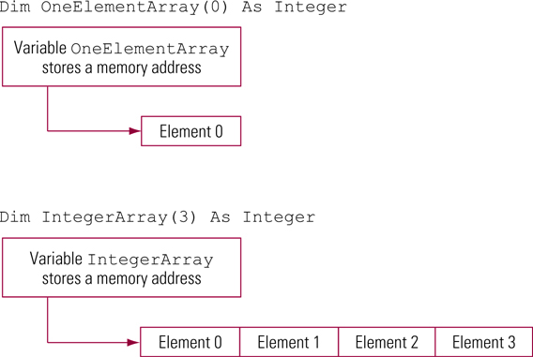
How Memory is Allocated to an Array (VB)
1/4/2016 9:36 PM

Slide 16
Initializing an Array
An array can be initialized when it is declared
The initialization list appears in braces ({})
A comma separates each initialization value
The array must be dynamic (declared without an initial subscript value)
Example to declare and initialize an Integer array with four elements and valid subscripts of 0 .. 3:
int integerArray() = {24, 12, 34, 42};
1/4/2016 9:36 PM

Slide 17
Declaring and Initializing an Array (VB)
1/4/2016 9:36 PM

Slide 18
Declaring and Initializing Boolean and String Arrays
Declare and initialize a Boolean array
Boolean [] WeekDayArray =
{false, false, true, true, true, true, true};
Declare and initialize a String array
String [] MonthNames =
{"January", "February", "March", "April", "May",
"June", "July", "August", "September",
"October", "November", "December"};
1/4/2016 9:36 PM

Slide 19
Determining an Array's Bounds
The GetUpperBound method gets the largest subscript for a particular dimension
It returns the largest subscript, not the number of elements
The GetLowerBound method gets the smallest subscript for a particular dimension
The 0-based dimension is passed as an argument to each method
The method will throw an exception if the array dimension does not exist
1/4/2016 9:36 PM

Slide 20
Determining an Array's Bounds (Examples)
Get the lower and upper bound of the first array dimension for the array named MonthNames
int smallestSubscript, largestSubscript;
smallestSubscript = MonthNames.GetLowerBound(0); // Result = 0
largestSubscript =
MonthNames.GetUpperBound(0); // Result = 12
1/4/2016 9:36 PM

Slide 21
Re-Using an Array
An array's size is determined by the number of dimensions in the array and the number of elements in each dimension
An array in C# cannot be re-dimensioned in the same sense as is possible in VB, but it can be “reused” via re-declaration
This causes the existing array to be destroyed and a new one to be created (as per strings)
Data in the original is not saved
If the size of an array cannot be determined at execution time, you should use a List or perhaps a non-linear structure (tree, graph, etc)
1/4/2016 9:36 PM

Slide 22
Performing Assignment Statements with Arrays
Assignment statements using arrays require a subscript
The subscript appears in parentheses after the array name
The data types of the left and right side of the assignment statement must be compatible
1/4/2016 9:36 PM

Slide 23
Assignment Statements with Arrays (Example)
Declare an array with 12 elements (subscript values from 0 to 11)
double [12] SalesList;
Store and retrieve a value from the second array element (a subscript value of 1)
Sales[1] = 84616.12;
double SalesListItem = SalesList[1];
1/4/2016 9:36 PM

Slide 24
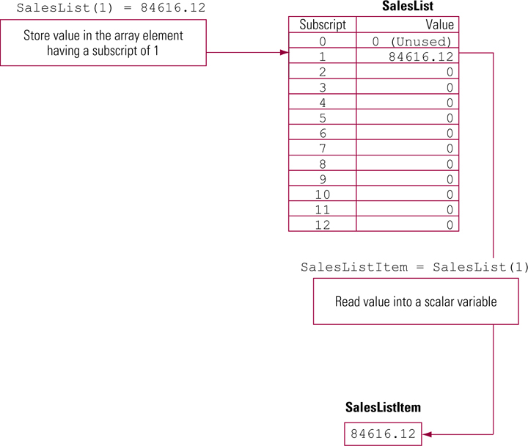
Storing and Retrieving Array Values (VB)
1/4/2016 9:36 PM

Slide 25
Understanding Arrays of Different Types (VB) - 1 (optional)
We begin by looking at some code →
This code illustrates the formation of arrays of objects (the parent data type of all other types in C#) as well as arrays of integers, and user-defined classes
Integers, other built-in types and user-defined types are all classes derived from the object class
We can therefore store objects of any of these types in a array of objects
1/4/2016 9:36 PM

Slide 26
Arrays of Different Type Data (VB) – 2 (optional)
1/4/2016 9:36 PM

Slide 27
Arrays of Different Types of Data – 3 (VB) (optional)
There are some important things to note in this code
1. aStruct and aClass are defined elsewhere
2. The methods discussed earlier on arrays of a single type still work the same here for generic arrays
Recall that there was an issue of what happens when primitive types are inserted into a list.
There is no such issue for arrays UNLESS we have created an array of type object or any type derived from object
1/4/2016 9:36 PM

Slide 28
Arrays of Different Types of Data – 4 (VB) (optional)
Arrays of reference type variables contain elements that are references to their actual elements which are stored in the heap

Slide 29
Arrays of Different Types of Data – 5 (optional)
Note that primitive types are stored in an array of base type object must be boxed and described in an earlier lecture set
In other words, if it becomes necessary to store data of a primitive type “as an object” we must first convert the data from the primitive type to the object type and THEN store it
1/4/2016 9:36 PM

Slide 30
Variables and Array Subscripts
Variables are often used as array subscripts
Especially when using loops to examine all the elements in an array
Variables used as subscripts must have an integral data type
1/4/2016 9:36 PM

Slide 31
Variables and Array Subscripts (Example)
Reference an array element with a variable as a subscript:
int SubscriptValue = 1;
double SalesListItem;
SalesListItem = SalesList[SubscriptValue];
1/4/2016 9:36 PM

Slide 32
Using Loops to Examine Array Elements
Common array tasks involving loops
Calculate the total value of all array elements using an accumulator
Calculate the minimum value stored in an array
Calculate the maximum value stored in an array
Calculate the average value of the elements in an array
1/4/2016 9:36 PM

Slide 33
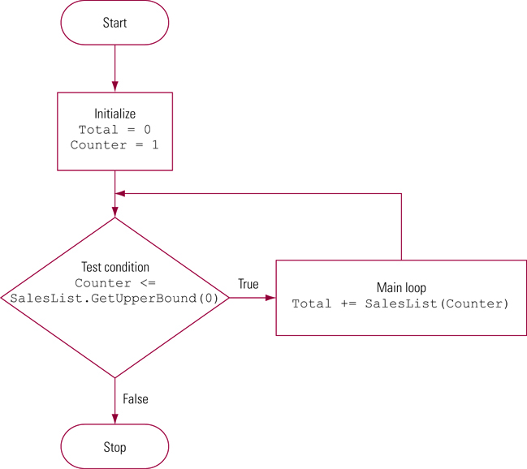
Using a Loop to Examine Array Elements (VB)
1/4/2016 9:36 PM

Slide 34
Examine an Array's Elements (Example)
Tally the values of an array's elements. Total contains the total value
double total = 0.0;
int counter = 1;
while (counter <= salesList.GetUpperBound(0))
{
Total += salesList[Counter];
counter++;
} // end while loop
1/4/2016 9:36 PM

Slide 35
Common Array Errors
Errors are commonly made when processing arrays
Forgetting to include a subscript
int [12] DemoArray;
DemoArray = 100;
Subscript out of range errors
int [10] DemoArray;
DemoArray[20] = 100;
DemoArray[–1] = 100;
1/4/2016 9:36 PM

Slide 36
Common Array Errors (continued)
Forgetting to examine the first or last array element
int [12] demoArray;
double total;
for (int cntr = 1;
cntr <= demoArray.GetUpperBound(0);
cntr++)
{
total += demoArray(cntr)
} // end for
1/4/2016 9:36 PM

