Slide 1
Lecture Set 9
Arrays, Collections and Repetition
Part B – More Complex Array Operations

Slide 2
Objectives
Understanding fundamental algorithms operating on arrays
Constructing these algorithms
Analyzing efficiency
Finding specific array elements – minima, maxima
Finding specific keys in an array (searching)
Sorting arrays
Working with multi-dimensional arrays
Working with arrays of objects
1/7/2016 12:30 PM

Slide 3
Determining the Minimum Value of an Array Element
First, initialize the current minimum value
Use the value of the first array element, or
Use the largest value for the underlying data type
Use a loop to find the current minimum value comparing the current minimum value with the current array element
Replace the current minimum value, if necessary
1/7/2016 12:30 PM

Slide 4
Determining the Minimum Value of an Array
Find the minimum value in the array named salesList
Note the first element is not used in the example
double currentMinimum = salesList[1];
for (int cntr = 2; cntr <= salesList.GetUpperBound[0]; cntr++)
{
if (currentMinimum > salesList[cntr])
{
currentMinimum = SalesList[cntr];
} // end If
} // end for
1/7/2016 12:30 PM

Slide 5
Determining the Maximum Value of an Array
The process is nearly the same as finding the minimum value
The condition in the decision statement is reversed
Initialize the current minimum value to the value of the first element or the minimum value for the data type
Change the minimum value example into a maximum value code snippet
1/7/2016 12:30 PM

Slide 6
Determining the Average Value of an Array's Elements
Using an accumulator, tally the value of all array elements
Divide the total value by the number of array elements to determine the average
1/7/2016 12:30 PM

Slide 7
Determining the Average Value of an Array (Example)
Store in Average, the value of all array elements
Note the first element is used
int cntr;
double total, average;
for (cntr = 0; cntr < salesList.GetUpperBound(0); cntr++)
total += salesList(cntr);
average = total / salesList.GetUpperBound(0);
1/7/2016 12:30 PM

Slide 8
Arrays as Function Arguments
An array can be passed to a function as an argument
In the function declaration, declare the argument with brackets
Example:
public double Total(double argList[])
{
// ... function body
} // end function
1/7/2016 12:30 PM

Slide 9
Sorting Array Elements
Use the Sort method of the System.Array class to sort array elements
All the elements of the array will be sorted
To sort part of an array you have to write your own sort or use a List
Example:
double sampleArray[] = {6.11, 4.12, 5.88, 6.44};
Array.Sort(sampleArray);
Example output:
4.12 5.88 6.11, 6.44
1/7/2016 12:30 PM

Slide 10
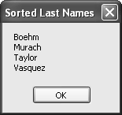
Using the Sort Method
1/7/2016 12:30 PM

Slide 11
Declaring One Array with Two Names
1/7/2016 12:30 PM

Slide 12
Copying one Array to Another
1/7/2016 12:30 PM

Slide 13
1/7/2016 12:30 PM

Slide 14
1/7/2016 12:30 PM

Slide 15
Reversing Array Elements
Calling the Reverse method of the System.Array class reverses the order of the array elements
It's possible to reverse all array elements or a range of elements
The arguments to the Reverse method are the same as the arguments to the Sort method
Example:
Array.Reverse(SampleArray)
1/7/2016 12:30 PM

Slide 16
Introduction to Searching
It's often necessary to search for an array element
Searching can be performed in different ways
A sequential search examines each element, in order, until the element is found or the entire array has been searched
A sorted array can be efficiently searched using a binary search (see p. 230-31 in text). You could write your own binary search?
1/7/2016 12:30 PM

Slide 17
Using a Sequential Search
A sequential search works on an unordered (unsorted) array
Each element is examined sequentially using a loop
If the item is found, the loop exits
If all elements are examined, the item is not found and the loop exits
You could write this easily?
1/7/2016 12:30 PM

Slide 18
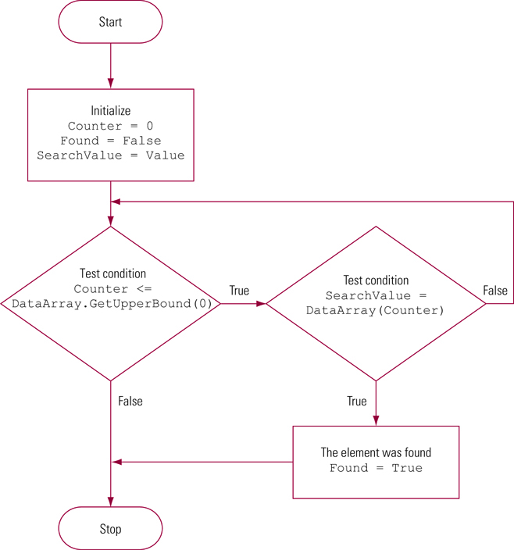
Searching for an Element in an Unordered Array
1/7/2016 12:30 PM

Slide 19
Using a Sequential Search (Example)
Search for a value in the array named dataArray
int searchValue;
Boolean found = false;
searchValue = ToInt32(txtSearch.Text);
for (int cntr = 0; cntr <= dataArray.GetUpperBound(0); cntr++)
{
if (searchValue == dataArray[cntr])
{
found = true;
break;
} // end if
} // end for
1/7/2016 12:30 PM

Slide 20
Using a Binary Search
If an array is sorted, a binary search can be used to find an array element
The performance is much better than a sequential search
Algorithm
Compare the search value with the value of the item in the middle of the array
Divide the array in half based on the results
Continue the previous two steps until the desired array element is found
1/7/2016 12:30 PM

Slide 21
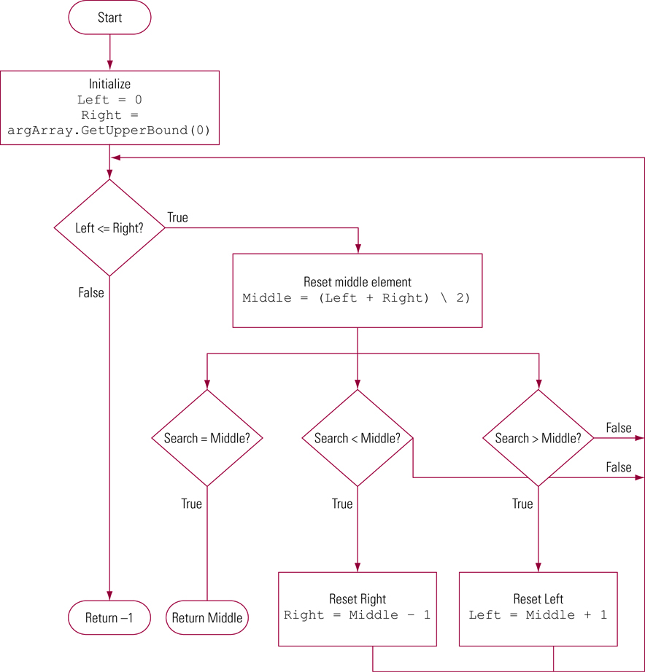
Binary Search Flowchart
1/7/2016 12:30 PM

Slide 22
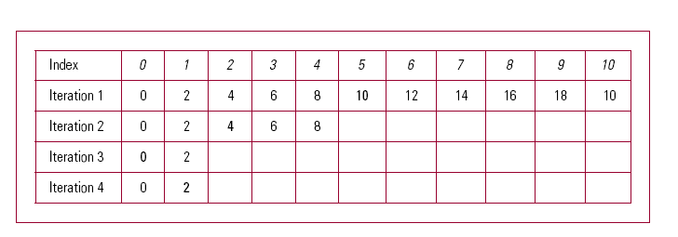
Comparisons Using the Binary Search
1/7/2016 12:30 PM

