Slide 1
Lecture Set 10
Windows Controls and Forms
Part B – Radio Buttons, Check Boxes, and Group Controls

Slide 2
Objectives
Understand how radio buttons, check boxes, and group boxes function
To be able to design and code a form using any of the controls introduced to date.
Given a form with two or more controls, set the tab order of the controls
Review information about multi-form projects
There is not much new in here that you don’t already know – so you may want to skip these slides

Slide 3
Group Boxes
Used to group controls together
Sometimes affects the behavior of the controls
Sometime used for clarity of the form and code related to the form
Group is shown on the form
A name may be associated with the group and is displayed in upper left corner of the box
All group controls move with the group box
Group boxes cannot be dragged over controls
Controls must be dragged or entered into the group box

Slide 4
Radio Buttons and Check Boxes
Radio buttons in a group are mutually exclusive
If you select one button all the others are turned off
Check boxes operate independently
When a user selects a check box it has no impact on the other boxes

Slide 5
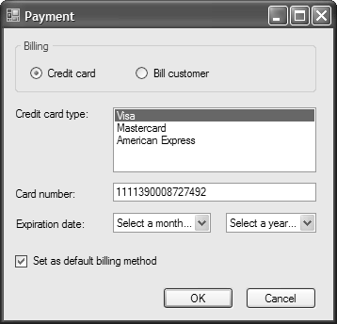
Sample Form with Five Control Types

Slide 6
Common Members of Radio Buttons and Check Box Controls
These controls are specializations of the same parent control ( ) and therefore have some common and some distinguishing members

Slide 7
Code that Manipulates Radio Button and Check Box Controls

Slide 8
Tab Order in a Form
When you display a form in Tab Order view you see the tab order values as assigned to each control
The next slide shows what this looks like
The slide after shows how to change tab order
Note that the tab order for labels normally is irrelevant as labels never get focus

Slide 9
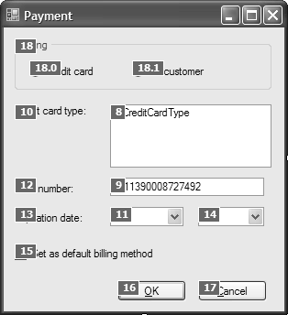
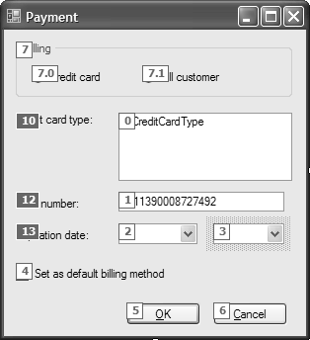
Form in Tab Order View

Slide 11
Getting Information About Controls
There are more than 60 different controls provided by Windows 2005
Most of what you will learn about these controls you will learn on your own
The book provides some information
I don’t provide much (I don’t know much)
So you are often on your own
Exam question – How do you find out what you need to know?
Use Microsoft Help?

Slide 12
Getting help from Microsoft
There is a better way
GOOGLE IT!!!!!
But if you must use Microsoft – use the Index Command in the Help menu to find what your looking for (if you can narrow down and spell what you are looking for)
Extra! Extra! Read all about it!!! Well – you’re too young to remember this,

Slide 13
Adding a New Form to a Project

Slide 15
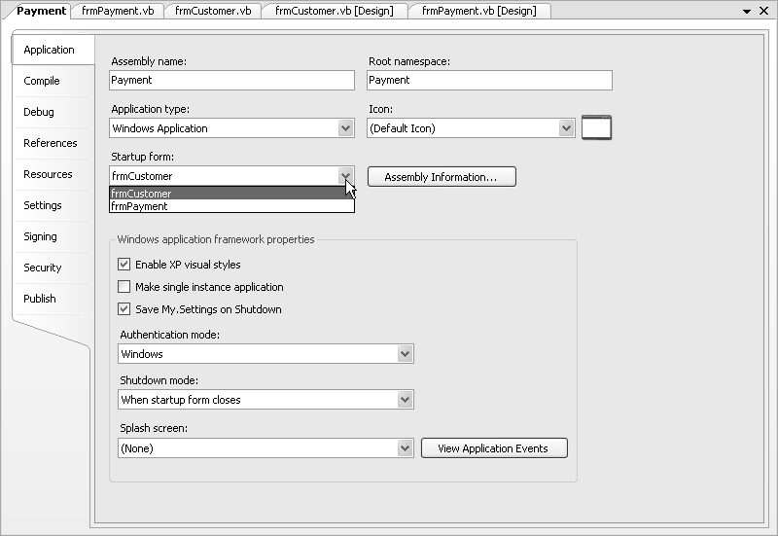
Changing the Start-up Form
Use the Application page of the Project Designer to change the Start-up Form
Double click on the Project on My Project and then on the Application Tab

Slide 16
Displaying a Form as a Dialog Box
A form displayed as a dialog box is also called a modal form
The Payment Form in the next slide is a modal form
The Payment Form is displayed when the user clicks on the Select Payment button (sorry – not shown) on the Customer Form
This assumes there is such a button and
That you wrote the code to display the modal form

Slide 17
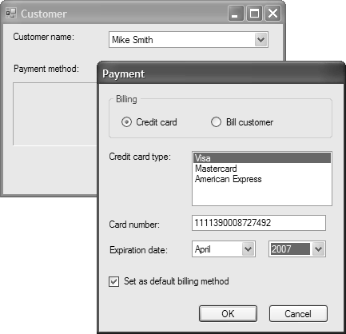

Slide 18
A Modal Form
When you create a form as a dialog box, you do so via the settings shown on the next slide →
As shown in the next slide →, you first use the New keyword to create an instance of the Form
Then you call the ShowDialog method of the
When you use this method to display a form, the user has to respond to the dialog box before the code that follows the ShowDialog call can execute

