Slide 1
Lecture Set 11
Creating and Using Classes
Part A - The Structure of an Application: Modules, and Classes

Slide 2
Objectives
Given the specifications for an application that uses classes with any of the members presented in this chapter, develop the application and its classes.
To understand the structure of an application and the C# elements in an application
List and describe the three layers of a three-layered application.
To understand the structure of a class and the elements in a class
Describe the concept of encapsulation

Slide 3
Objectives (continued)
Use class diagrams, the Class View window, and the Class Details window to review, delete, and start the members of the classes in a solution.
Use multiple forms and classes to build an application
Understand applications with multiple modules

Slide 4
Common Application Elements
Most Windows applications contain the following elements:
Forms (classes defined by you) with event handlers for the tools in the form
Other classes defined by the user (but not forms classes)
Still other classes from the FCL and other libraries
Splash screens (also written as a class)
Other “stuff” –
Bitmap files
Login forms
Text files
About boxes

Slide 5
The Structure of an Application
Often viewed in three layers
Presentation layer
The user interface – forms components
Middle Layer
The application layer, consisting of components specialized for the applications domain involved
Business, University, Games, Bio-medical etc
Serves as the intermediary between the presentation and database/files layers
Database Layer
Components to support the database abstraction
SQL, Access, Oracle, other

Slide 6
1/6/2016 8:33 PM

Slide 7
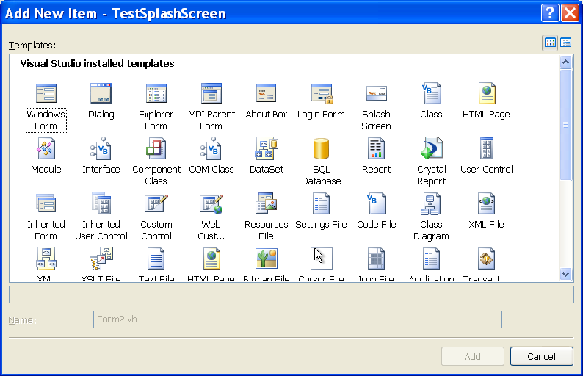
Life Made Too Easy (VB) – Adding Classes
You can get anything you want at Alice’s restaurant (Arlo Guthrie – from before you were born)
You can Add anything you want (to your solution) from Microsoft’s restaurant

Slide 8
Common Class Elements – C Sharp
Classes contain other elements:
Methods – functions in C#, and subs and functions in VB – operations that can be performed by an object.
Constructors – special type of method that’s executed when an object is instantiated
Data stores
Numerous objects of types defined by other classes
Variables (of primitive types)
Events (and Event handlers -- not always tied to forms) – an event is a signal that notifies other objects that something noteworthy has occurred

Slide 9
Common Class Elements (continued)
User defined data types – structures, enumerations, complex structured types (arrays of structures, lists or arrays of objects, etc)
Delegate - A special type of object that’s used to wire an event to a method
Operator - A special type of method that’s performed for a C# operator such as +, -, or =.

Slide 10
1/6/2016 8:33 PM

Slide 11
Splash Screens
So what is a Splash Screen?
You play games? You have seen splash screens →
A start-up form that displays while an application is loading (Word and Excel have them – you should be preparing one for your Hangman Game or whatever other game you write)
.NET actually provides a ready-made place to specify a Splash Screen
C# does not seem to have such a special form

Slide 12
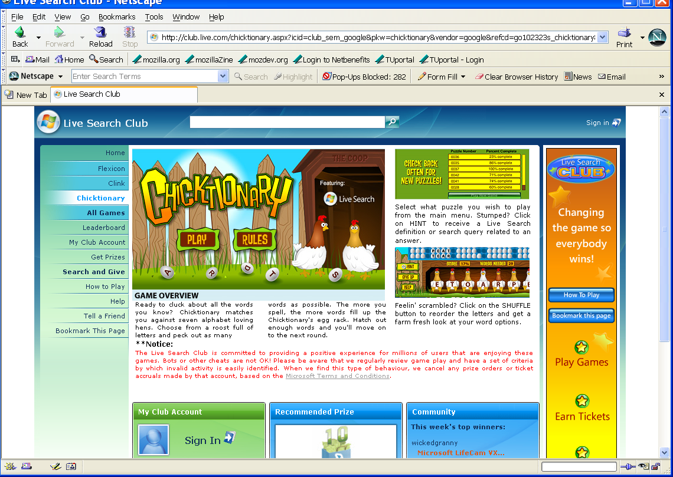
Splash Screen for a Game
1/6/2016 8:33 PM

Slide 13
Functions and Access Modifiers
Access modifiers control the visibility of procedures
A Private function can only be called from the class containing its declaration
Functions declared with the Public and
We will discuss these access modifiers more in Lecture Set 11C

Slide 14
Introduction to Applications with Multiple Components (Classes, Forms)
Applications can contain multiple forms, and Classes
Each form and Class appears in the Solution Explorer
A physical file can contain Classes and multiple forms
Forms are implemented as partial classes. The other part of the form class is generated by the Windows Forms Designer and can be examined as a forms.designer file

Slide 15
The Solution Explorer Containing Multiple Components

Slide 16
Adding a Component to an Application
Click Project, Add New Item to activate the Add New Item dialog box
Select the item to add from the list of installed templates
Class
Windows form
And many others
Assign a name to the new item
Note that the templates vary based on the installed Visual Studio edition

Slide 17
Operations on Forms
Form instances must be created
Forms must be displayed
Visible forms must be hidden or closed
Form events can be handled

Slide 18
Creating and Displaying Multiple Form Instances
There are three ways to create a form, but we focus on one of these:
Explicitly create an instance of the form class and call the Show method to display it
The other two ways (not discussed here) include
Use the default form instance provided by the My.Forms object
Use the default form instance name

Slide 19
Creating a Form Instance Explicitly
Create a form instance the same way as any class instance would be created
Example to create an instance of the form named frmAbout:
public class frmAbout : Form
{
// Inherits the Form class
// Methods and data stores unique to this class
} // end frmAbout Class
// Create new object of type frmAbout
frmAbout frmNewInstance = new frmAbout;
// Reset the form’s caption
frmNewInstance.Text = "About Form“;

Slide 20
Displaying Forms
Once created, a form must be displayed
A form can be displayed in two ways
As a modal form
Modal forms must be hidden or closed before the parent form can be displayed
Display by calling the ShowDialog method
As a modeless form
The end user can change input focus between modeless forms at will
Display by calling the Show method

Slide 21
Displaying Forms (Example)
Display a form as a modal dialog box
frmAbout.ShowDialog();
Display a form as a modeless dialog box
frmAbout.Show();

Slide 22
Hiding and Closing a Form
A form can be hidden
The objects for a hidden form still exist
Call the Hide method to hide a form
The Visible property is set to False
frmAbout.Hide();
frmAbout.Visible = false;
A form can be closed
The objects for a closed form are destroyed
Call the Close method to close a form
this.Close;

Slide 23
Introduction to Form Events
Events fire as a form gets focus and loses focus
The Activated event fires each time a form gets focus
The Deactivate event fires each time a form loses focus
The Load event fires when a form is loaded into memory
The FormClosing event fires just before a form is unloaded from memory
After a form has closed, the FormClosed event fires

Slide 24
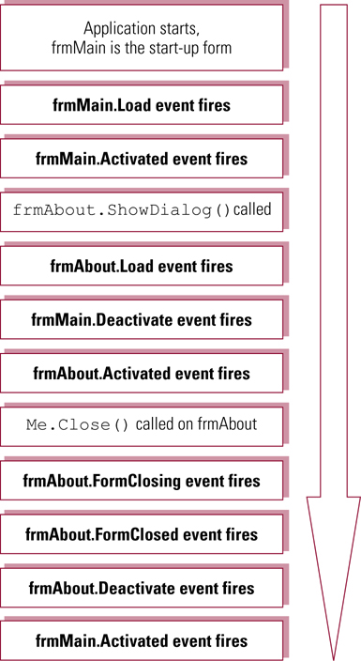
Order of Form Events

Slide 25
Viewing Class Attributes
You can view a project’s classes and each classes attributes (fields, methods, and properties) by
Right clicking on the project name (the second line in the Solution Explorer window)
Left clicking on the View Class Diagram entry in the resulting drop down menu
An example follows →

Slide 26
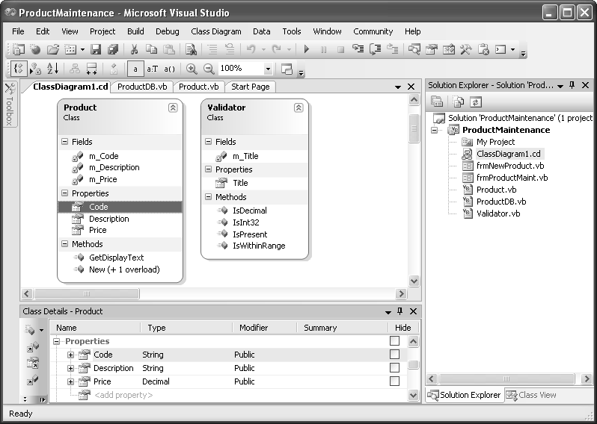
1/6/2016 8:33 PM

