Slide 1
Lecture Set 11
Creating and Using Classes
Part C – Advanced Topics on Classes - Communication Across Classes, Class Design

Slide 2
Objectives
Understanding access rights for different kinds of class variables
Variable Accessibility (review)
Designing classes (using UML)
Informal UML for Class design
8/24/2013 10:01 PM

Slide 3
Access Rights for Class Variables
Public variables can be shared between forms (classes) and other assemblies
Private variables can only be used by the class containing the declaration
Protected variables can only be used by the class containing the declaration AND any class the is derived
It is generally NOT a good idea to declare public variables in a class as it defeats the purposes of encapsulation/information hiding
8/24/2013 10:01 PM

Slide 4
User-Defined Classes (review)
User-defined classes, in addition to those supported by the .NET Framework class library classes, can be created and reused by the programmer
Class features
A class has a constructor
Classes typically have methods
Classes typically have private fields
Classes typically have constants
Classes often contain definitions of internal data types
Classes may have events
Classes may have static methods and attributes
8/24/2013 10:02 PM

Slide 5
Introduction to Class Design
Encapsulation refers to the coupling of data and the processes that operate on that data
Data should only be modified by functions or methods in the class that contains the data
Classes have an interface and an implementation
The interface consists of the exposed methods, and events
The interface is used by other developers
The implementation forms the hidden part of the class
The implementation is hidden from the developers using the class
Classes should be designed to model problem domain data entities or software entities required to solve a problem
8/24/2013 10:02 PM

Slide 6
Introduction to UML Class Diagrams
A class can be modeled using a UML class diagram
A UML class diagram has three compartments divided by horizontal lines
The top compartment contains the class name
The middle compartment contains the attributes (properties)
The lower compartment contains the operations (methods)
8/24/2013 10:02 PM

Slide 7
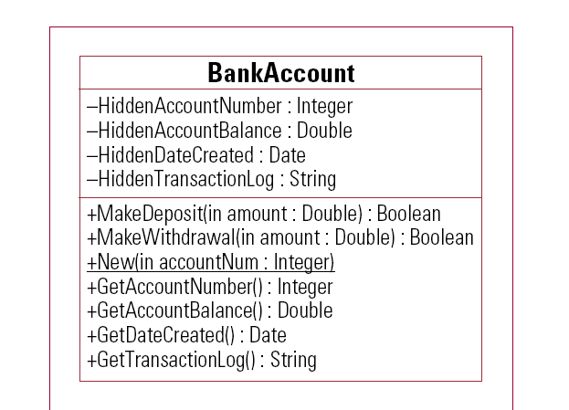
UML Class Diagram
8/24/2013 10:02 PM

Slide 8
UML Class Diagram (Analysis)
Plus and minus signs denote whether the attribute or operation is public (+) or private (-)
Arguments appear in the declaration
in indicates an input argument
The data type of a method's return value also appears following a full colon (:)
8/24/2013 10:02 PM

Slide 9
UML Class Diagrams (Associations)
Associations depict a relationship between two classes
Classes can have many associations
A person can have bank accounts and other types of accounts, for example
A bank can have accounts for many persons
Does this remind you of anything from your database course? It should
8/24/2013 10:02 PM

Slide 10
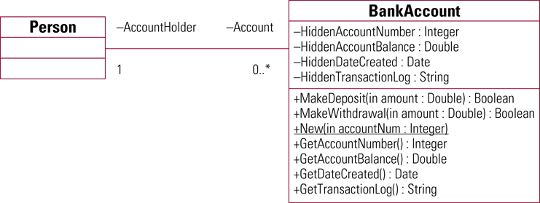
UML Class Diagram with Associations
8/24/2013 10:02 PM

Slide 11
UML Process (Behavior) Diagram (Example)
8/24/2013 10:02 PM

Slide 12
Informal UML Diagrams
I find UML Class Diagrams to be too confining for the purposes of this course
I prefer instead that we use more detailed versions of UML
For lack of a better name, I will call these Unboxed Class Diagrams (UCDs)
They are also called Activity Diagrams
UCDs (ADs) are similar to UML in that they contain the same descriptive components (and others)
Class Name and statement of purpose (contract)
Attributes (fields, properties, constants); Exceptions
Methods (incl. constructors and non-public methods)
New data types; shared methods and data
8/24/2013 10:02 PM

Slide 13
Informal (UML) Class Diagrams
Examples of more information UML class diagrams are shown on the next page
Note that even given the less formal representations of Class diagrams, UML association diagrams can still be drawn, and all the other features of UML used
Examples of informal UML diagrams are shown on the next few slides →
8/24/2013 10:02 PM

Slide 14
Informal Class Descriptions
Not every class description will contain entries for each of the features
Class Name and statement of purpose (contract)
Attributes (fields, constants)
Exceptions
Methods (including constructors and non-public methods)
New data types
A very important aspect of these informal class diagrams is that they encourage more complete thinking about method arguments and return values
These descriptions will be iteratively enhanced as your software development work moves on to more detailed steps
8/24/2013 10:02 PM

Slide 15
More on Constructors
Every C# class has a constructor
If you do not provide one, the compiler gives you a default constructor
You can, AND SHOULD, write your own constructor(s) even if one of them has no arguments and does nothing
In C# a constructor is a special public function with the same name as the class
A constructor is called automatically when a class instance is created
8/24/2013 10:02 PM

Slide 16
Constructors (continued, with an example)
Constructors can accept 0, 1, or many arguments
The argument list determines which constructor is called when overloaded constructors are used
A constructor without arguments
public class BankAccount
{
private DateTime HiddenDateCreated;
public BankAccount()
{
HiddenDateCreated = DateTime.Now;
} // end constructor
} // end class
8/24/2013 10:02 PM

Slide 17
Constructor (Example, continued)
A constructor with arguments
public class BankAccount
{
private DateTime HiddenDateCreated;
private int HiddenAccountNumber;
public BankAccount(int accountNum)
{
HiddenDateCreated = DateTime.Now;
HiddenAccountNumber = accountNum;
} // end Constructor
} // end class
8/24/2013 10:02 PM

Slide 18
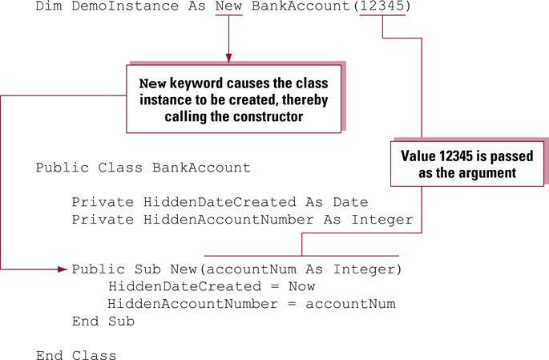
Calling a Constructor (VB code)
8/24/2013 10:02 PM

Slide 19
Creating Methods
Classes have a name, attributes, and operations
Operations are called methods
Methods are implemented as public functions
Note that Private functions are part of the implementation of the class and are not considered methods that are part of the class interface
8/24/2013 10:02 PM

Slide 20
Creating Methods (Example)
Create a method named MakeWithdrawal to decrease the account balance
public class BankAccount
{
private double HiddenAccountBalance;
public double MakeWithdrawal(double amount)
{
HiddenAccountBalance -= amount;
} // end MakeWithdrawal
} // end Class
8/24/2013 10:02 PM

