Slide 1
Lecture Set 13
Drawing
Mouse and Keyboard Events
Part A - Drawing

Slide 2
Objectives
Describe the purpose of the graphics device interface (GDI)
Describe how to draw
When a paint even fires
By creating the graphics event associated with a control
Create custom colors and use the ColorDialog control
Use named pens and brushes and create custom pens and brushes
Create shapes and paint them on the screen

Slide 3
Introduction to Drawing
Windows drawing services are collectively referred to as the graphics device interface (GDI)
The GDI (now GDI+) has classes to define shapes (lines, rectangles, ellipses, arcs, pies) and to draw them
You can also draw text and 2-D images
Shapes are drawn to a graphics surface (screen or printer)
Without the GDI, shapes would have to be drawn manually pixel-by-pixel

Slide 4
The GDI+
Makes its home in the System.Drawing namespace
GDI+ is new with .NET
GDI+ builds on old Windows drawing system
GDI+ features include surfaces, drawing inks, drawing elements, & drawing transformations
GDI+ generalizes bitmap and vector drawing on all surfaces – the screen (form and control surfaces), a printer, a JPEG file (to name a few)
All such destinations are treated the same

Slide 5
More on the GDI+
GDI+ manages to generalize drawing surfaces through the System.Drawing.Graphics class
An object of this class represents a drawing canvas with all the attributes you can think of
Colors, brushes, pens
Drawing elements such as rectangles, ellipses, lines, and other standard and custom shapes
Fonts
Transformations – rotate, resize, skew

Slide 6
Still More on the GDI+
Some controls take care of their own display features
Others let you take over all or some of the drawing features
GDI+ is huge and complex – we will see about 1% of its capabilities

Slide 7
Introduction to the Paint Event
Shapes are rendered to a form during the Paint event
Other controls, such as a PictureBox, support the Paint event too
There is no design-time mechanism to draw shapes
What does this mean?
Shapes do not support events
What does this mean?
The end user has no interaction with a shape drawn on a graphics surface
Shapes can only be drawn to a graphics surface such as a form or PictureBox or some other controls such as a ListBox which allow you some control over its appearance

Slide 8
Selecting a Canvas
Most drawing in .NET is done within the context of a Graphics Object (on which you draw everything)
There is always a surface behind the graphics object
Any drawing to a graphics object is drawn to this surface as well
The graphics object includes many methods that let you draw “things” on the graphics surface

Slide 9
Drawing to a Form
This next example illustrates one way to draw on a form (using the paint event handler) →
Remember that this handler fires whenever a form is drawn or resized
The handler also fires when a minimized form is maximized or restored
And, it fires when an obscured or partially obscured form in unobscured
A paint event also fires when the Invalidate method of the underlying form or Picturebox control is called
Some events, most notably the paint event for forms and controls provide direct access to a graphics object through its arguments.

Slide 10
Drawing to a Form (Example)
The second argument to the paint handler has data type PaintEventArgs. It also has a property named Graphics. The graphics object referenced by the Graphics property provides the link to the GDI.

Slide 11
Drawing to a PictureBox
All controls, such as Labels, Buttons, Forms and Pictureboxes have their own graphics contexts.
To draw on a control, you first obtain its graphics object by invoking the control’s method CreateGraphics →
Then you can use the methods in the graphics class to draw on that object
In the example on the next page, we pass the Picturebox control, p, to an enclosing paint function
(see Slides 18 and 20 for example)
Then we create the graphics object for the Picturebox surface and store the reference to this object in curgraph
Now we are ready to “draw on” the graphics object
This object provides the link to the GDI

Slide 12
Drawing to a PictureBox (Example)

Slide 13
The Classes of the GDI+
The System.Drawing namespace contains classes and structures that define shapes
The System.Drawing.Drawing2D namespace contains additional shapes not supported by older versions of Windows
Windows 98 and Windows ME, for example
The System.Drawing.Graphics class contains methods to draw graphical shapes
This is where we will focus our energies

Slide 14
The Purpose of the System.Drawing Namespace
It contains structures that define graphical shapes
It contains other structures and classes that describe visual characteristics of graphical shapes (System.Drawing.Color, System.Drawing.Pen)
It contains the Graphics class, which is used to draw shapes to a graphics surface
So – we need this namespace to do our work
Why? Well, let’s review for a moment a similar explanation related to files (but adapted to fit the need to do graphics)

Slide 15
An Underlying Framework
Already visited this idea for files (Chapter 10 and databases (Chapter 11). Now we revisit it a third time for doing graphics
Remember …
In your programs, you manipulate objects using methods belonging to the class that defines the type of the object
The class (an abstract data type) is an abstraction (model) of the object being manipulated

Slide 16
The Object Framework 1
Recall, too …
In all these cases, we must …
Design and implement a class to model the entity to be manipulated
The class is said to define an “abstract data type”
We can then create objects (instances of the class we just created)
Next comes the tricky part … →

Slide 17
The Object Framework 2
We now have to connect that object to the actual entity to be drawn on
For graphics the object is an instance of a class that provides an abstract view of a graphics entity such as a drawing. This view is modeled by the Graphics class
So we program against elements of the graphics class (and some other related classes) without concern for the underlying structures
For example, whether we are drawing on a splash screen, a form, a picbox, or some other tool makes no difference – we simply program against the graphics object we instantiate and let the underlying class to the work

Slide 18
The Object Framework 3 – The Connection
The graphics abstraction (methods and data stores) of a physical surface that you program against
(pens, colors, rectangles, ellipses, lines, fonts, etc.)
The actual, physical surface to be drawn on (splash screen, form, picbox, etc)
The connection – via creation of a graphics object
public void DrawPicChanges(PictureBox p)
Rectangle curRec;
Color curCol;
...
'A picture box is not a graphics object. Create graphics object.
'Then drawing can be done
curGraph = p.CreateGraphics;
...

Slide 19
The Object Framework 4 – Why Bother
Why do this – what is this all about?
The abstraction enables us to manipulate graphics objects in a uniform, consistent way, regardless of the underlying structure of the file or the operating system that manages the file
The underlying structure actually being drawn on is hidden under several layers of software

Slide 20
The Object Framework 5 – Why Bother
All we need to do is connect the graphics object to the underlying surface being drawn on (a form, splash screen, picbox …)
Example: From Hangman
Graphics curGraph;
. . .
// Subroutine to Draw Changes in Picture Box
// Input Arg is picture box where picture is to be drawn
public void DrawPicChanges(PictureBox p)
{
. . .
curGraph = p.CreateGraphics();
Programmer layer – draw “on” a graphics object (curgraph)
↓
Logical layer – manages the drawing on the surface connected to the graphics object (the picture box)
↓
Physical layer – manages the actual (physical) drawing of pixels to a physical entity (the physical representation of the picture box)

Slide 21
The Object Framework 6 – Why Bother
The central issue is this: Your programming task is made easier because …
You program against a (generalized) abstraction of a real “thing” and not against the thing itself.
You do not need to worry about the details of the underlying surface being drawn on but just the methods and properties provided to you by the abstraction (the given graphics class)

Slide 22
Drawing a First Shape
Drawing operations should be performed in the Paint event
The data type of the second argument is PaintEventArgs
Remember: The Graphics property stores a reference to an instance of the Graphics class with which drawing is performed
The DrawLine method is used to draw a line using a Pen

Slide 23
Drawing a First Shape (Example)
Draw a red line using a Pen
private void frmMain_Paint(object sender,
System.Windows.Forms.PaintEventArgs e)
{
e.Graphics.DrawLine(Pens.Red, 10, 10, 150, 150);
} // end frmMain_Paint

Slide 24
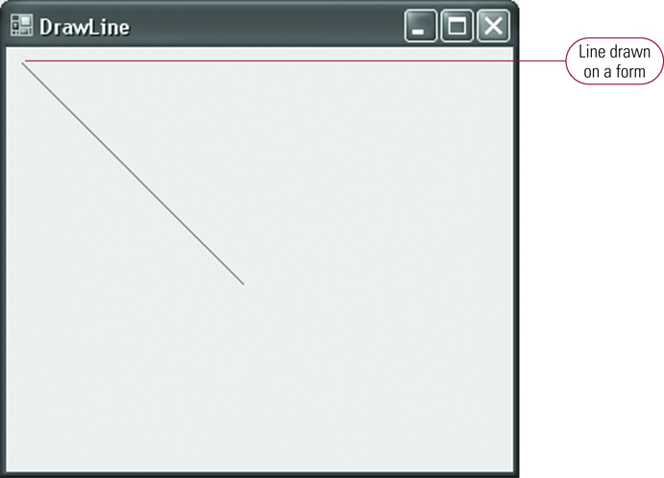
Figure 12-1: Drawing a Line

Slide 25
Understanding the Paint Event
Several actions cause the Paint event to fire
The Paint event fires when the form is drawn
The Paint event fires when a form is resized
The Paint event fires when a minimized form is restored or maximized
The Paint event fires when an obscured form is no longer obscured
The Paint event fires when the Invalidate method is called

Slide 26
Understanding Color
Computer monitors display colors by combining varying intensities of red, green, and blue
The term RGB is short for red, green, blue
RGB values range between 0 and 255
0 indicates the color is off
255 indicates the color is applied at its full intensity

Slide 27
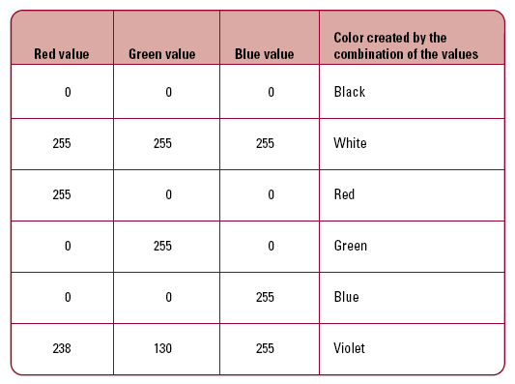
Table 12-1: Sample RGB Colors

Slide 28
Introduction to the color Structure
Visual Studio supports several named colors using the Color structure
Examples to set the background and foreground colors of a Label using named colors:
lblDemo.BackColor = Color.Gray;
lblDemo.ForeColor = Color.DarkBlue;

Slide 29
The Color Structure (Members)
The R property gets the red component of a color
The G property gets the green component of a color
The B property gets the blue component of a color
The FromArgb method creates a color from RGB values
The ToArgb method returns a 32-bit Integer representing a color

Slide 30
The ColorDialog Control
The ColorDialog control works like other dialog controls
The ShowDialog method displays the dialog box
The selected color is stored in the Color property
The control instance appears in the resizable tray below the Windows Forms Designer

Slide 31
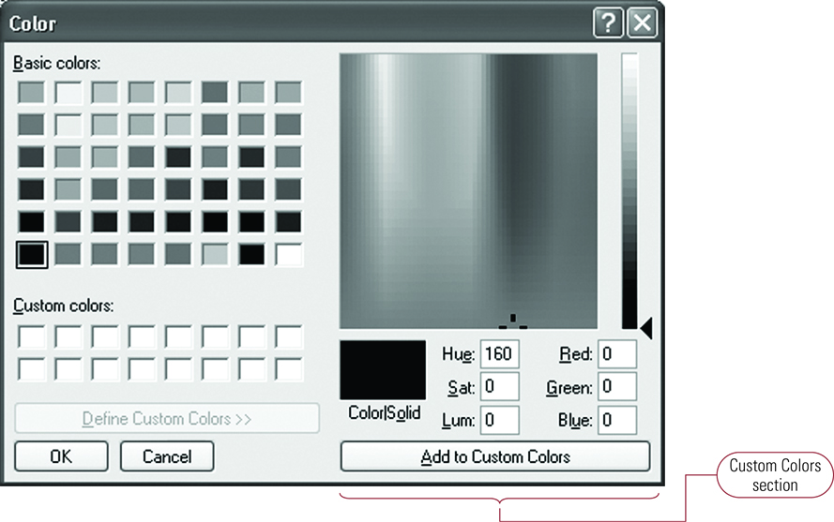
Figure 12-2: Color Dialog Box

Slide 32
Introduction to Pens and Brushes
Pens are used to draw lines and outline other shapes
The Pens class contains named pens
The Pen class is used to create custom pens
Brushes are used to fill shapes
The Brushes class contains named brushes
The SolidBrush class is used to create custom brushes
Call the Dispose method to explicitly release the resources held by custom pens and brushes

Slide 33
Using Pens to Outline Shapes
A named pen can be used to draw a line as follows:
e.Graphics.DrawLine
(Pens.Red, 10, 10, 150, 150);

Slide 34
The Pen Constructor
Use the Pen constructor to create a custom Pen
The first argument contains a color
The second argument contains the width of the Pen
The width is measured in pixels
Examples:
Color CurrentColor = Color.FromArgb(122, 89, 94);
Pen CurrentPen2Pixel = new Pen(CurrentColor, 2);
e.Graphics.DrawLine(CurrentPen2Pixel,10,10,150,150);

Slide 35
Using Brushes to Fill Shapes
A Brush is used to fill the region of a shape such as a rectangle
Brushes inherit from the System.Drawing.Brush class
Visual Studio supports different types of brushes
A SolidBrush has a single color
A HatchBrush has a background color and a pattern

Slide 36
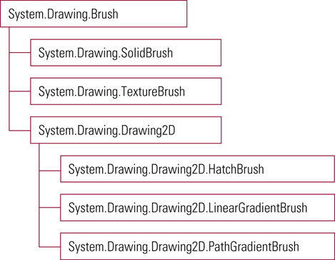
Figure 12-4: Hierarchical Organization of the Brush Classes

Slide 37
Shapes Defined by the System.Drawing Namespace
The Point structure defines the x and y coordinates of a point
The Size structure defines the width and height of another graphical shape such as a rectangle
The Rectangle structure defines the origin and size of a rectangle
The Rectangle structure is also used as the basis for other shapes such as ellipses

Slide 38
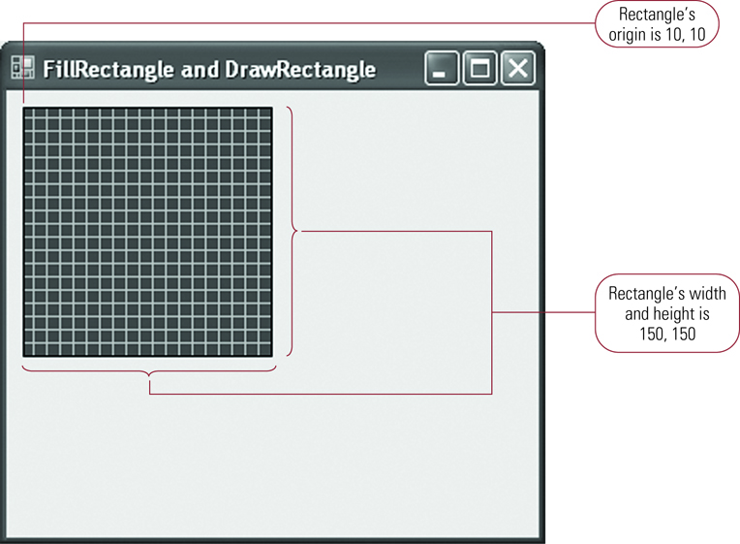
Figure 12-5: Filling and Outlining a Rectangle

Slide 39
The Point Structure
The Point constructor accepts x and y coordinates as its arguments
The origin of the graphics surface is 0, 0
The unit of measure is pixels
Example:
Point CurrentPoint = new Point(10, 10);

Slide 40
The Size Structure
The Size structure accepts width and height values as arguments to the constructor
Values are measured in pixels
Example:
Size CurrentSize = New Size(150, 150);

Slide 41
The Client Area
Graphical shapes are drawn to a form's client area
A form's client area excludes the form's border and title bar
The form's ClientSize property stores the size of the client area
Example:
btnFill.Size = this.ClientSize;
btnFill.Height = this.ClientSize.Height;
btnFill.Width = this.ClientSize.Width;

Slide 42
Creating a Rectangle
A Point structure defines a rectangle's origin
A Size structure defines a rectangle's size
The overloaded Rectangle constructor accepts either Point and Size structures or coordinate values

Slide 43
Creating a Rectangle (Examples)
Create rectangles using Point and Size structures or using coordinate values
Point currentPoint = new Point(10, 10);
Size currentSize = new Size(150, 150);
Rectangle firstRectangle = new
Rectangle(CurrentPoint, currentSize);
Rectangle secondRectangle = new Rectangle
(10, 10, 150, 150);

Slide 44
Drawing Rectangles
The DrawRectangle method draws a rectangle outline with a pen
The FillRectangle method fills a rectangle with a brush
Example to draw a rectangle outline:
Rectangle currentRectangle = new Rectangle
(10, 10, 150, 150);
e.Graphics.DrawRectangle(Pens.Black,
currentRectangle);
e.Graphics.DrawRectangle(Pens.Black,
10, 10, 150, 150);

Slide 45
Drawing Lines
The DrawLine method draws a line using a pen
Two points can be passed as arguments
A pair of x and y coordinates can be passed as arguments
Example:
Point startPoint = new Point(10, 10);
Point endPoint = new Point(150, 150);
e.Graphics.DrawLine(Pens.Red,
startPoint, endPoint);
e.Graphics.DrawLine(Pens.Red,
10, 10, 150, 150);

Slide 46
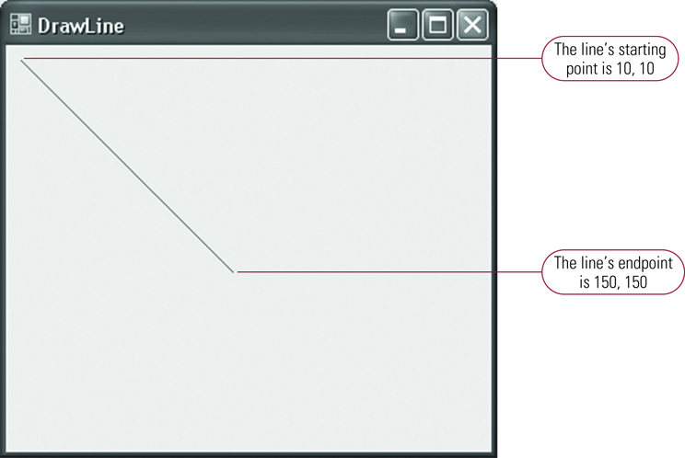
Figure 12-6: Drawing a Line on a Form

Slide 47
Introduction to Elliptical Shapes
The DrawEllipse method uses a bounding rectangle to draw an ellipse
The FillEllipse method fills an ellipse
The DrawArc method draws an arc
There is no method to fill an arc
The DrawPie and FillPie methods draw and fill a pie shape

Slide 48
Drawing and Filling an Ellipse (Example)
Rectangle currentRectangle = new Rectangle
(10, 10, 150, 150);
e.Graphics.DrawEllipse(Pens.Black,
currentRectangle);
e.Graphics.FillEllipse(Brushes.Red,
currentRectangle);

Slide 49
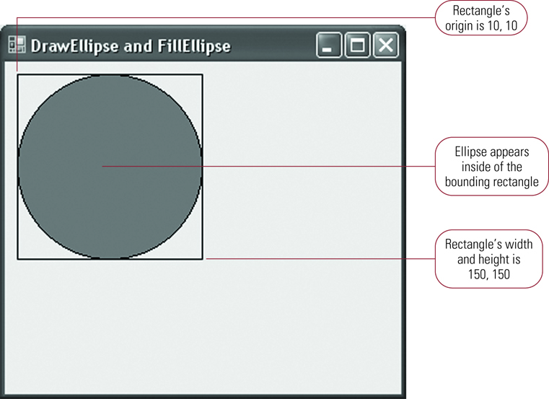
Figure 12-8: Drawing and Filling an Ellipse

Slide 50
Drawing Arcs
An arc is drawn along an ellipse
One argument contains the starting angle
Angles are measured in degrees
A starting angle of 0 appears along the x axis
Another argument contains the sweep angle
Positive sweep angles are drawn in a clockwise direction
Negative sweep angles are drawn in a counterclockwise direction

Slide 51
Drawing an Arc (Example)
Draw a 90 degree arc
Rectangle currentEllipse = new Rectangle
(10, 10, 150, 150);
e.Graphics.DrawArc(Pens.Red, currentEllipse, 0, 90);

Slide 52
Drawing an Arc

Slide 53
Creating a Pie Shape
The syntax is the same as drawing an arc
The DrawPie method draws an outline of the pie and the FillPie method fills the pie
Example:
Rectangle currentCircle = new Rectangle
(10, 10, 150, 150);
e.Graphics.FillPie(Brushes.Red,
currentCircle, 0, 45);
e.Graphics.DrawPie(Pens.Black,
currentCircle, 0, 45);

Slide 54
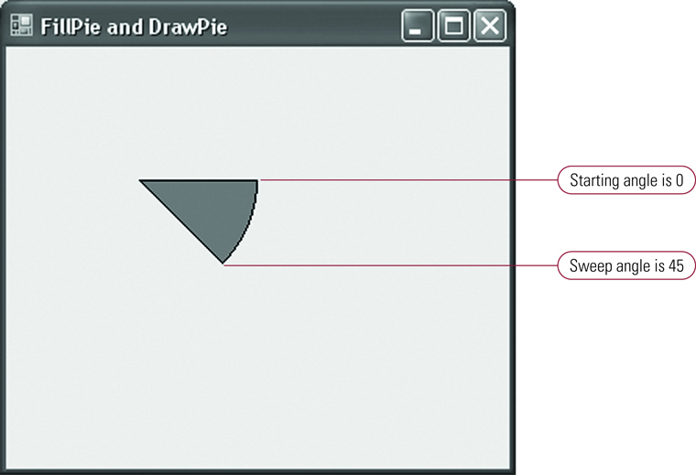
Figure 12-10: Filling and Drawing a Pie

Slide 55
Drawing Images
The FromFile method of the System.Drawing.Image class reads an image
The DrawImage method draws an image
An image can be drawn at a point
The image is not resized
An image can be drawn inside of a bounding rectangle
The image is resized to fit in the rectangle

Slide 56
Drawing Images (Example)
Image currentImage = Image();
Point pointOrigin = new Point(10, 10);
Rectangle imageRectangle = new Rectangle
(10, 10, 150, 150);
CurrentImage = Image.FromFile("C:\Image.bmp");
e.Graphics.DrawImage(currentImage, pointOrigin);
e.Graphics.DrawImage(currentImage, imageRectangle);

Slide 57
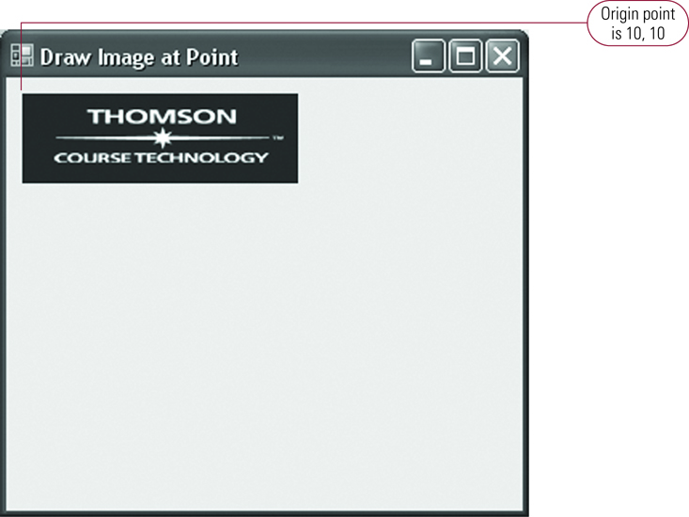
Rendering an Image at a Point

Slide 58
Rendering an Image in a Rectangle

